Slide 1


Engineering Management 101
Q4 Training Series · Module 1
Leadership Development Program
CONFIDENTIAL · Internal Use Only · Do Not Distribute
Copyright Dobromir Montauk 2026
Notes:
Engineering Management 101. Deliver it with a completely straight face, like the start of every training you’ve ever sat through. Let the pause run a beat too long.

Slide 2
The Job of an Engineering Manager
1. Winning
2. Increasing the Capacity to Win
CONFIDENTIAL · Internal Use Only · Slide 2
Copyright Dobromir Montauk 2026
Notes:
The job. Read it flatly. This is literally the whole talk, and it sounds like nothing. Ask the room what it actually means. Wait. Nobody will answer.

Slide 3
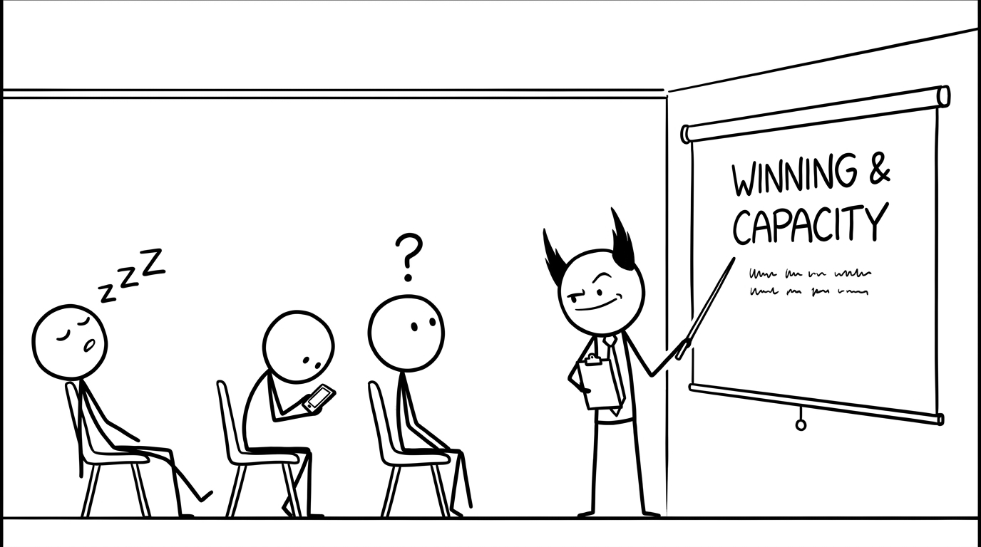
Copyright Dobromir Montauk 2026
Notes:
WTF? Admit it: I wrote that slide and I’m not sure either. “Winning” and “capacity” are words we nod along to in meetings. By the end of this, you should be able to use them to make a decision on Monday.

Slide 4
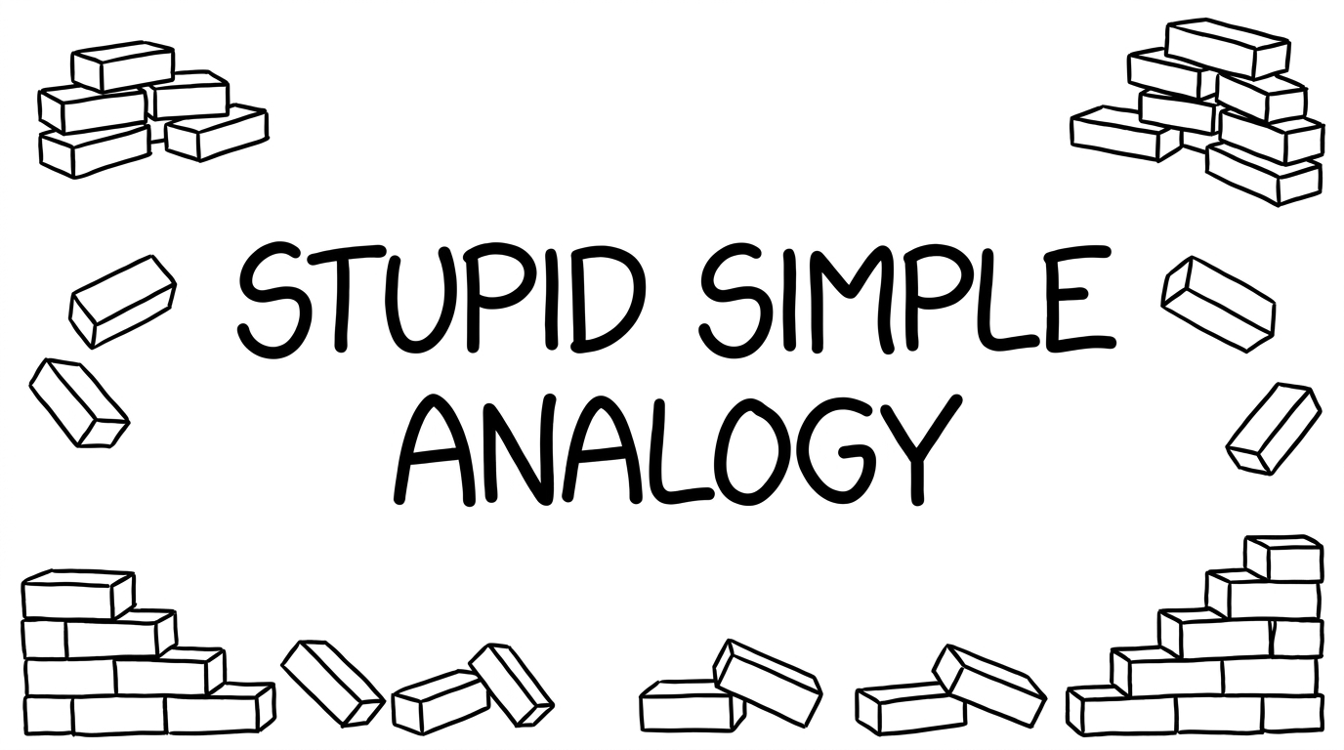
Copyright Dobromir Montauk 2026
Notes:
A stupid simple analogy. Let’s make it concrete with the simplest job imaginable: bricks.
(yes, because it is so stupid-simple, it won't map 1:1 with our jobs. That shouldn't prevent you from getting the lessons)

Slide 5
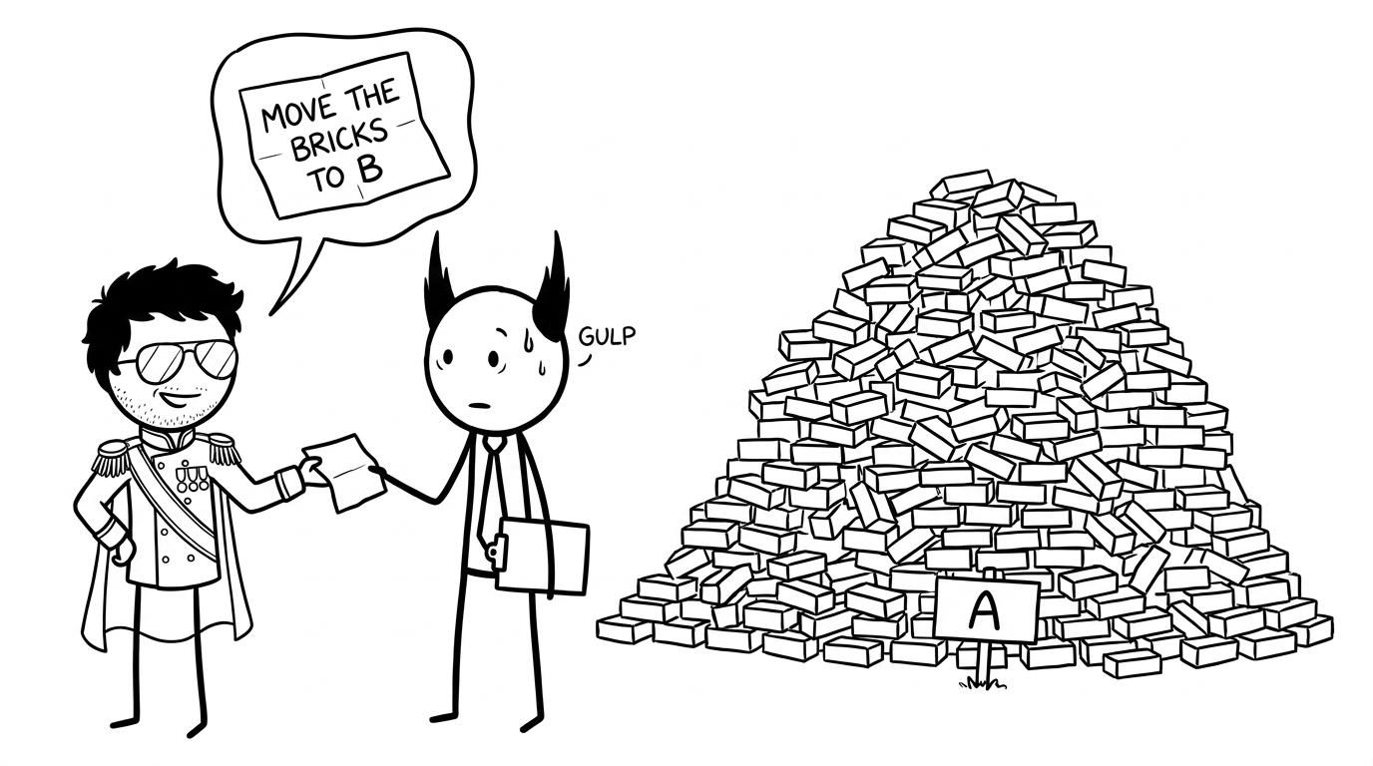
Copyright Dobromir Montauk 2026
Notes:
The note. Every EM gets some version of this note, usually with less detail. You have to build the team, and the technology, to get it done. Why bricks? Shipping features isn’t that different: units of value, hauled to a customer who’s waiting at the other end.

Slide 6
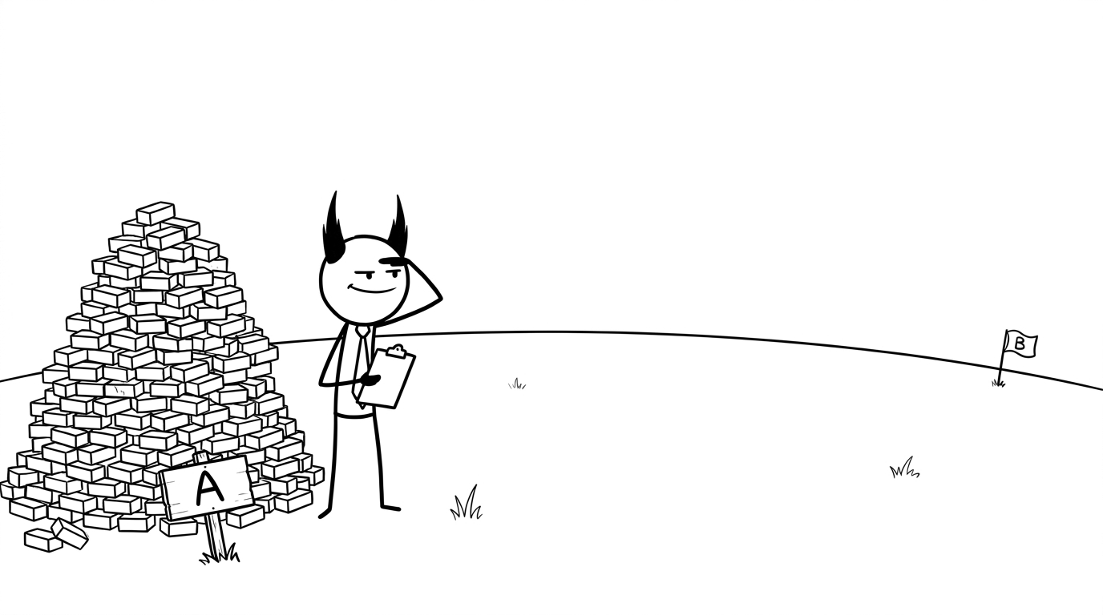
Copyright Dobromir Montauk 2026
Notes:
A to B. Notice what nobody told you: how big B is, how far away, or what’s in between. Every one of those unknowns is going to bite us later. Hold that thought.

Slide 7
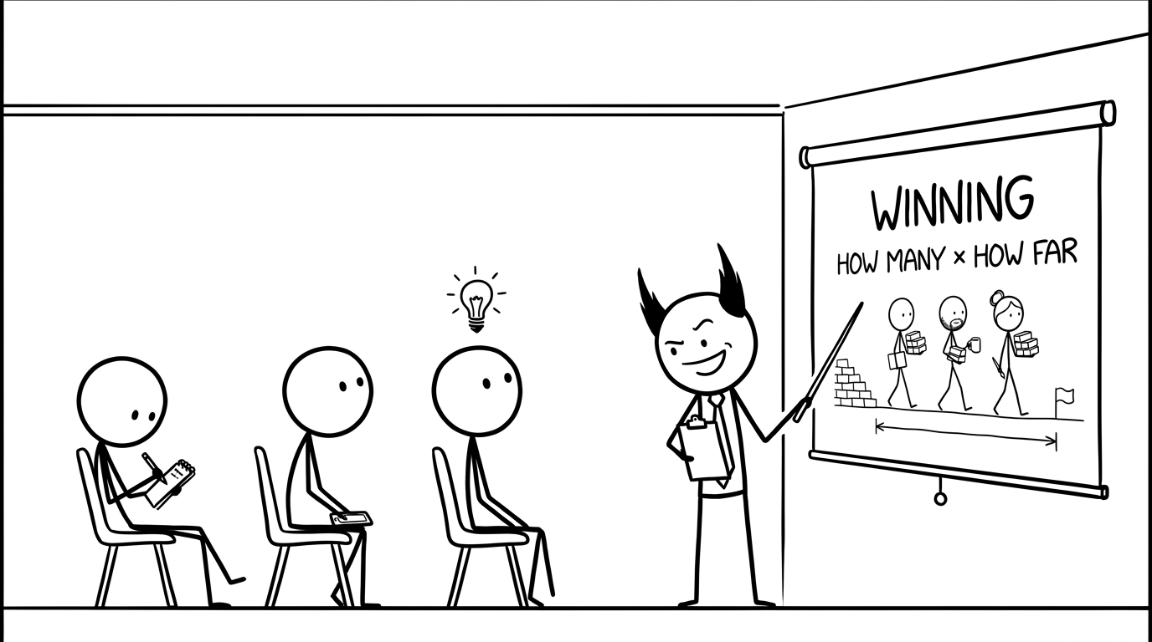
Copyright Dobromir Montauk 2026
Notes:
Winning. A win is one turn: one week of engineering. Both factors matter. A thousand bricks moved sideways scores zero; one brick delivered all the way counts. Ask the room: by this measure, what did your team win last week?

Slide 8
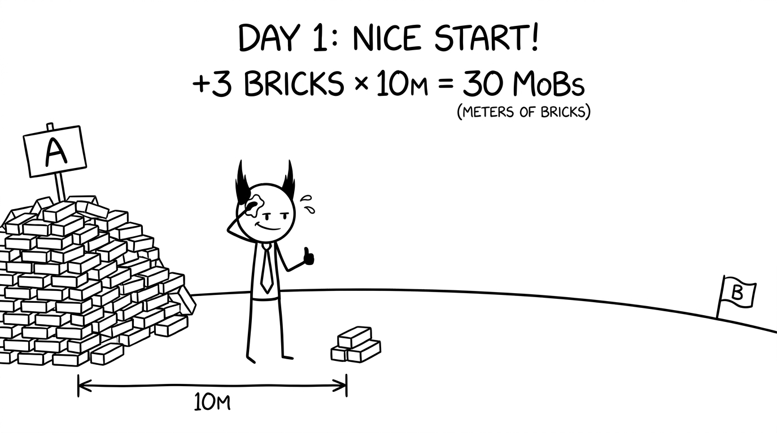
Copyright Dobromir Montauk 2026
Notes:
Day 1. Celebrate it: it’s a real, measurable win. Then do the math out loud. How many bricks are in that pile? How far is B? Let the room get a little uneasy.

Slide 9
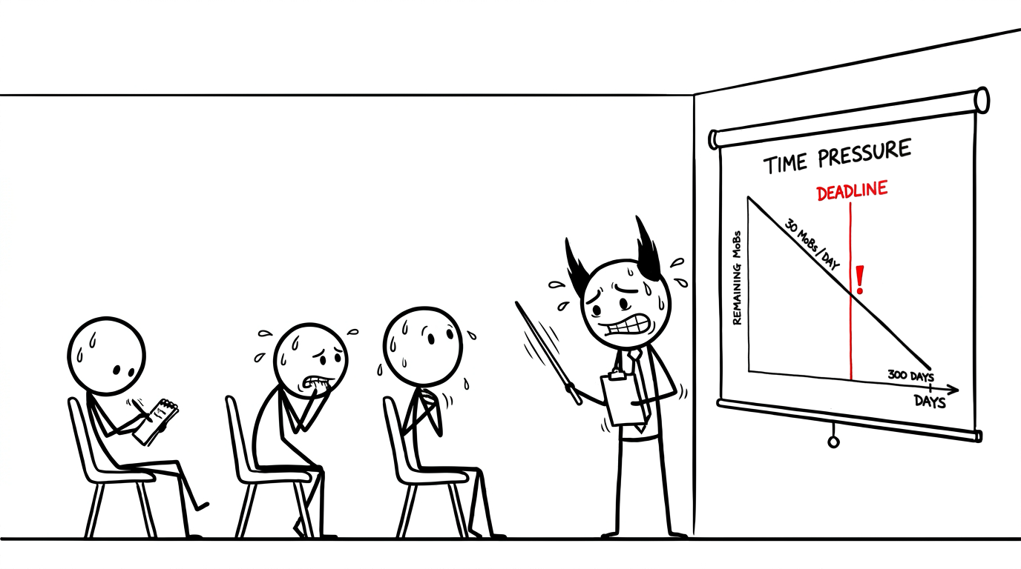
Copyright Dobromir Montauk 2026
Notes:
Time pressure. If ALL the bricks don’t arrive by date X, all that winning is worthless. Keep Day 1’s pace forever and we finish in 300 days; the deadline is months before that. This is the moment winning alone stops being enough.

Slide 10
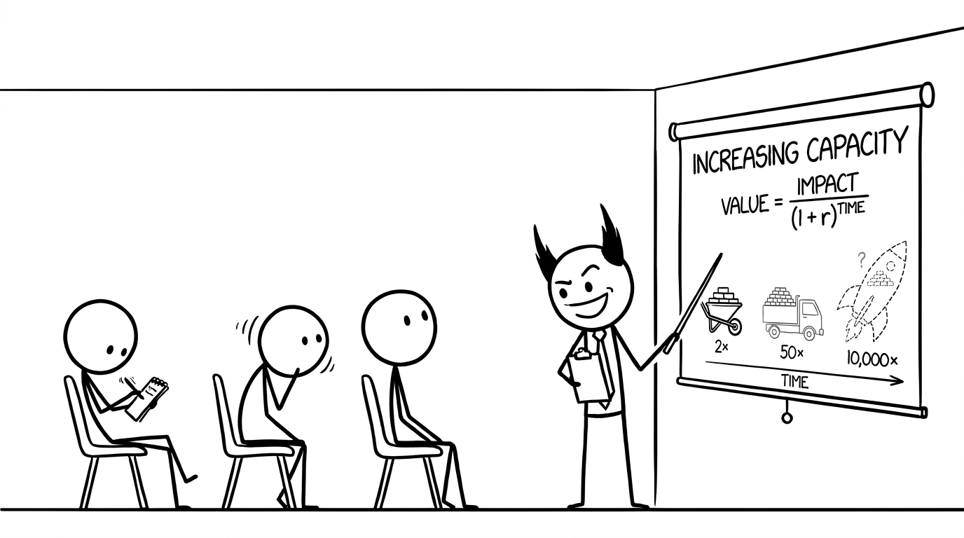
Copyright Dobromir Montauk 2026
Notes:
Capacity. Capacity is everything that doesn’t move a brick this week but lets you move more later: tools, roads, people, skills. Why discount? Because the future is uncertain. The truck might take two years; the Starship may never fly. With any real discount rate, the moonshot has to be enormously bigger to beat the wheelbarrow. The skill isn’t picking the biggest number; it’s picking the best impact for the time.

Slide 11
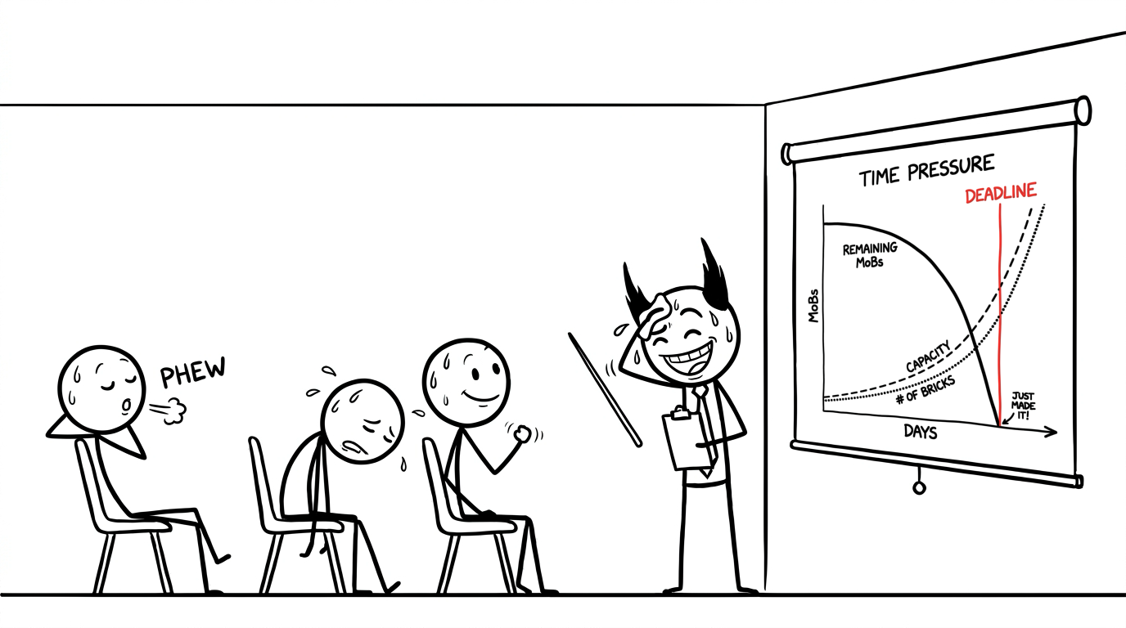
Copyright Dobromir Montauk 2026
Notes:
Capacity beats the deadline. Same deadline, same pile. What changed is capacity: better tools, more people, more bricks per trip, and it compounds. That’s how you beat a deadline you can’t beat at today’s pace. But “just made it” isn’t comfortable: one more surprise and we’re back on the scary slide.

Slide 12
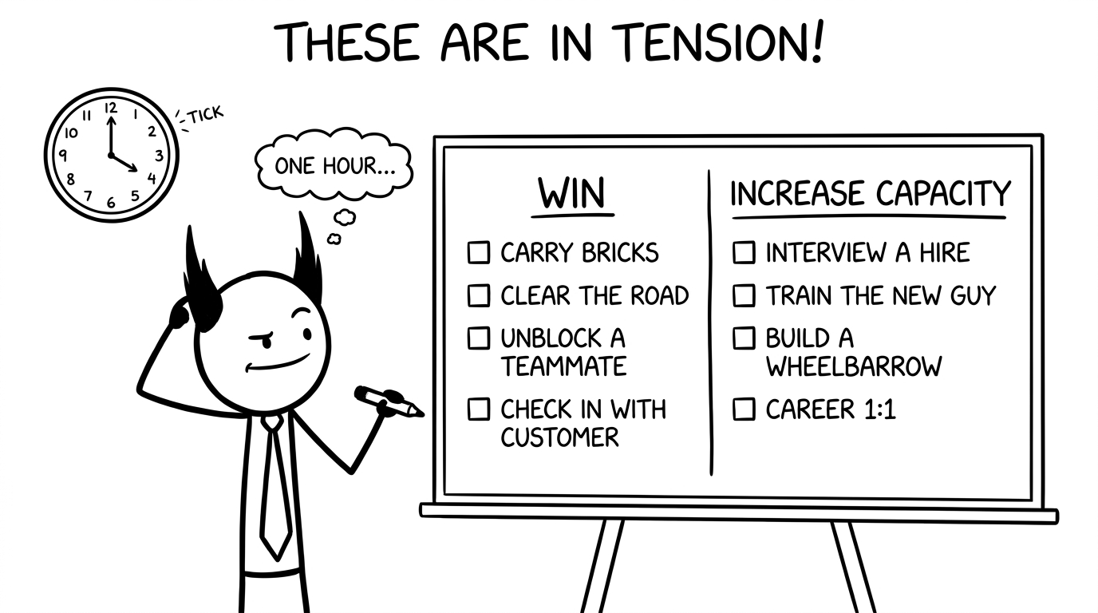
Copyright Dobromir Montauk 2026
Notes:
The tension. There’s no answer that’s always right. Some days the bricks have to move. Some days the best thing you can do is train the new guy. Every hour on one side is an hour not spent on the other. The rest of this talk is about making that call well, every hour, every day.

Slide 13
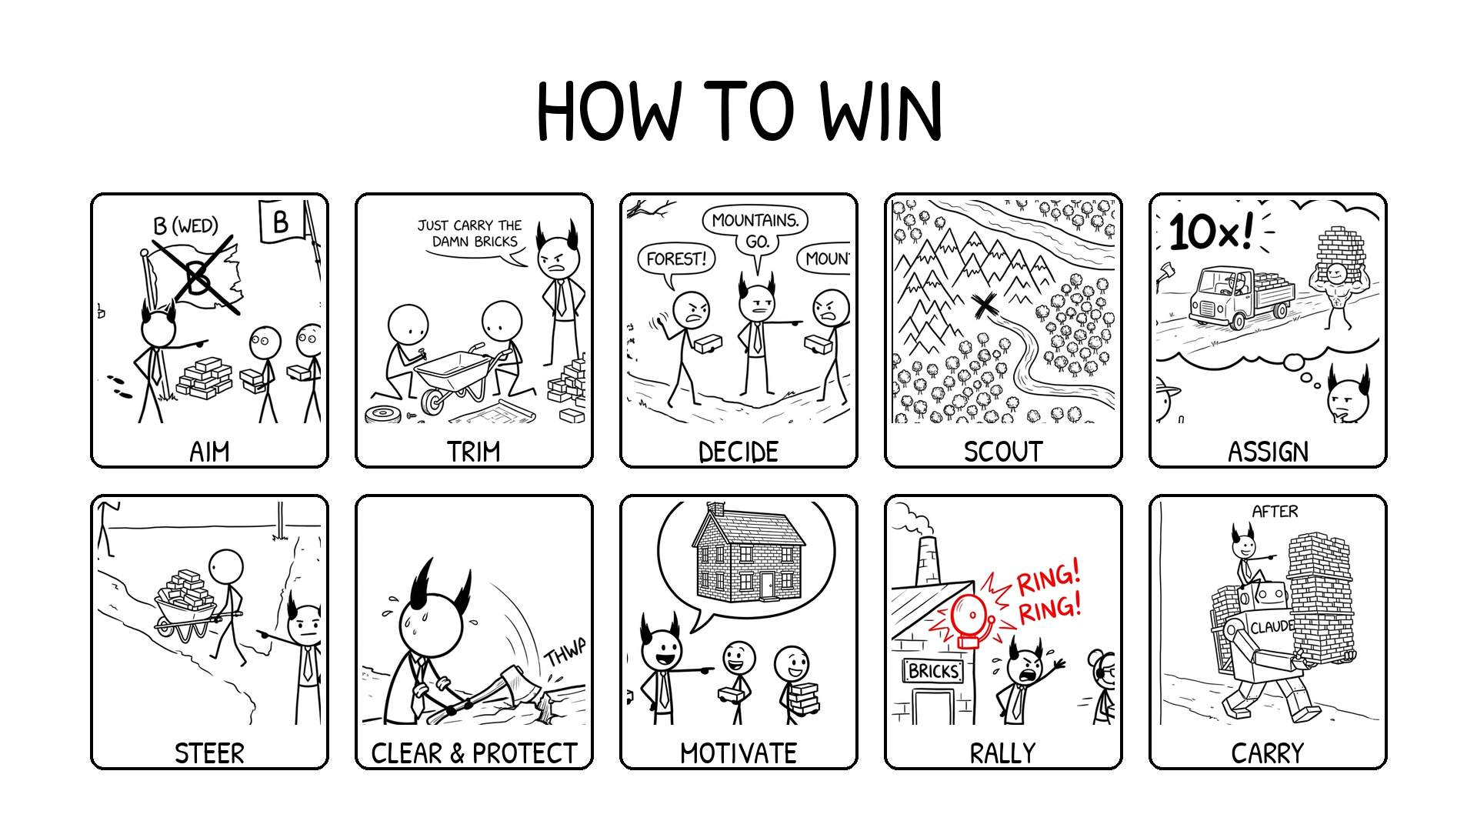
Copyright Dobromir Montauk 2026
Notes:
Each of these can be a whole course by itself. We're just going to lightly touch each one & give some examples so you can pattern match your activities to the bucket they fall into.

Slide 14
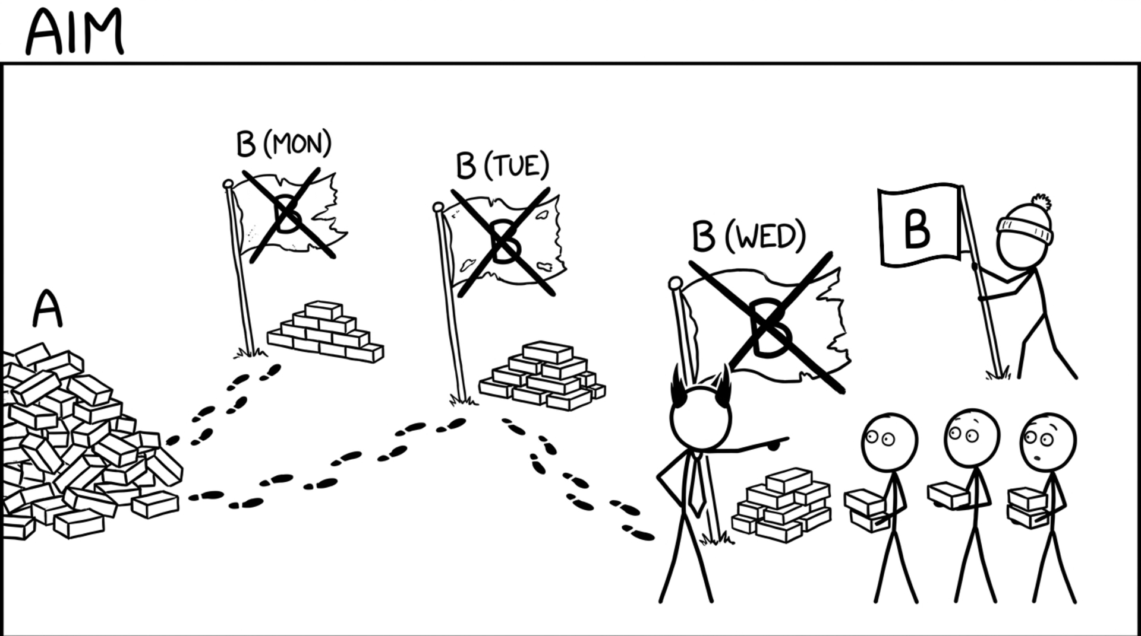
Copyright Dobromir Montauk 2026
Notes:
Goals move all of the time, for lots of different reasons. The work your team is does only matters if it takes you *in the direction of the goal* -- so even if you are a little off-track, you are wasting effort. Figuring out what is the actual goal will help THIS WEEK's work be maximally productive.
1. The feature for a deal that died. A team spends six weeks building a custom integration for a big prospect. The deal falls through. Nobody else wants the integration, so it sits in the codebase as a cost.
2. Built to someone else's understanding. The PM passes along what sales heard on a call. Engineering builds exactly that, but the customer meant something else, so it gets rebuilt. The first version was the passed-down scope, not the real one.
3. Polishing what's about to be replaced. Three weeks go into speeding up and hardening a service that leadership already plans to replace next quarter. Nobody told the team, and all the work dies with the old system.
4. Building on the API the customer is leaving. The team ships an integration against a vendor's v1 API, then learns the customer is migrating to v2 (or to a different vendor) next month.
5. Two teams, one problem, opposite directions. Two teams each build their own version of the same thing, like an auth library, a reporting pipeline or a config system. One version gets thrown out, along with the time spent arguing over which survives.
6. Gold-plating the prototype. A spike meant to answer "will this work?" gets tests, a CI pipeline and a nice UI. Then the answer comes back no.
7. The right feature for the wrong user. A powerful configuration screen gets built for admins, but the people who actually hit the problem are front-line staff, who never open that screen.

Slide 15
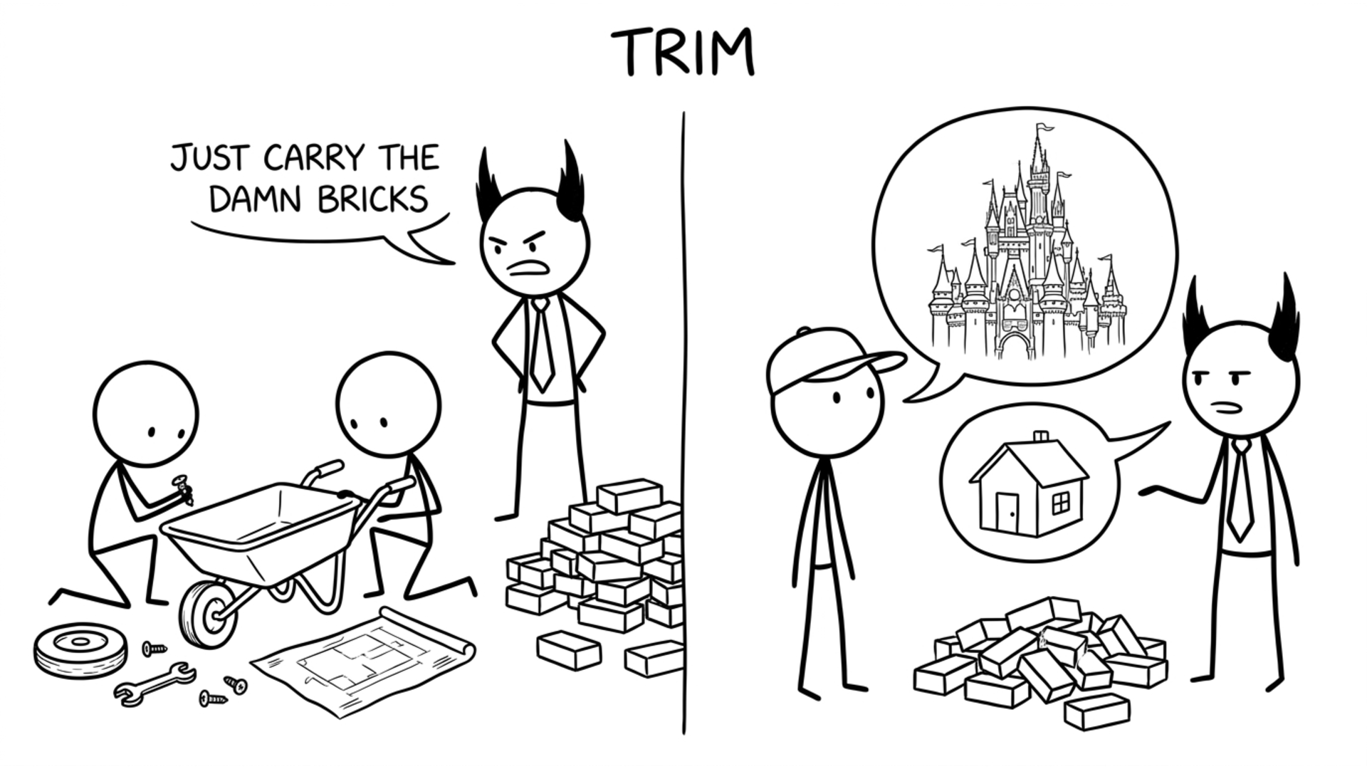
Copyright Dobromir Montauk 2026
Notes:
Trim. Two kinds of scope to cut. On the left, approach scope: the framework, the platform or the automation we would love to build first. Building tools is capacity, not winning, so do it on purpose, not by accident. On the right, product scope: the castle the customer asked for vs. the house they actually need this quarter.
Examples:
1. Approach scope. A request for one flag on one machine turned into a design for tiered config with merge rules and a new admin UI. Someone asked, "any objection to the hackiest possible approach?" A one-off override solved it that day.
2. Approach scope. An engineer wanted a generic plugin system first, so integrations would be "easy forever". There was one integration on the roadmap. Hard-code it; build the abstraction from three real examples later, not zero.
3. Approach scope. Support wanted an edge case automated before launch. How often does it happen? About once a week. Keep it manual for now, and launch.
4. The other side. A simple database index was suggested early and passed over because the tests weren't representative. Seven weeks later, under production load, the same index took the query from 4.5 s to 0.7 s.
5. Product scope. The customer asked for a full analytics dashboard: filters, charts, scheduled emails. The question "what decision is this for?" turned up one weekly number for the CFO. A nightly CSV export shipped in two days.
6. Product scope. The spec said "supports every payment type". The data said 97% of transactions were cards. Launch with cards, a month early; add the next type when a real customer asks.
7. Product scope. The plan included a full admin UI for config, roles and audit logs. The only users were three internal engineers. A documented script and a config file in the repo did the job and saved six weeks.
Caveat: a trimmed feature still has to be usable. Phase 1 can be manual, but call it a partial feature, not GA. "Done" means what the customer expects.

Slide 16
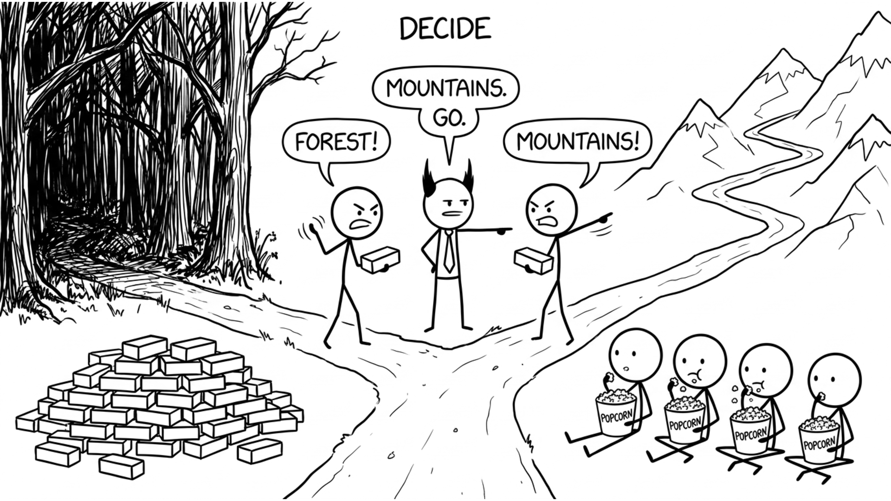
Copyright Dobromir Montauk 2026
Notes:
Decide. Often you have to make the call before you have enough data. Teams lose days, sometimes weeks, waiting on decisions nobody owns. The cost isn't the two people arguing; it's everyone blocked behind them.
- Two senior engineers debate the data model for two weeks while the rest of the team can't start.
- A design review ends with "let's take this offline" for the third time.
- A PR sits blocked on an architecture argument in the comments.
- "Which customer first?" goes unanswered, so people pick their own.
Most technical decisions are reversible. Set a deadline for the decision, hear both sides, make the call, write down why, and revisit if new data shows up. Disagree and commit.

Slide 17
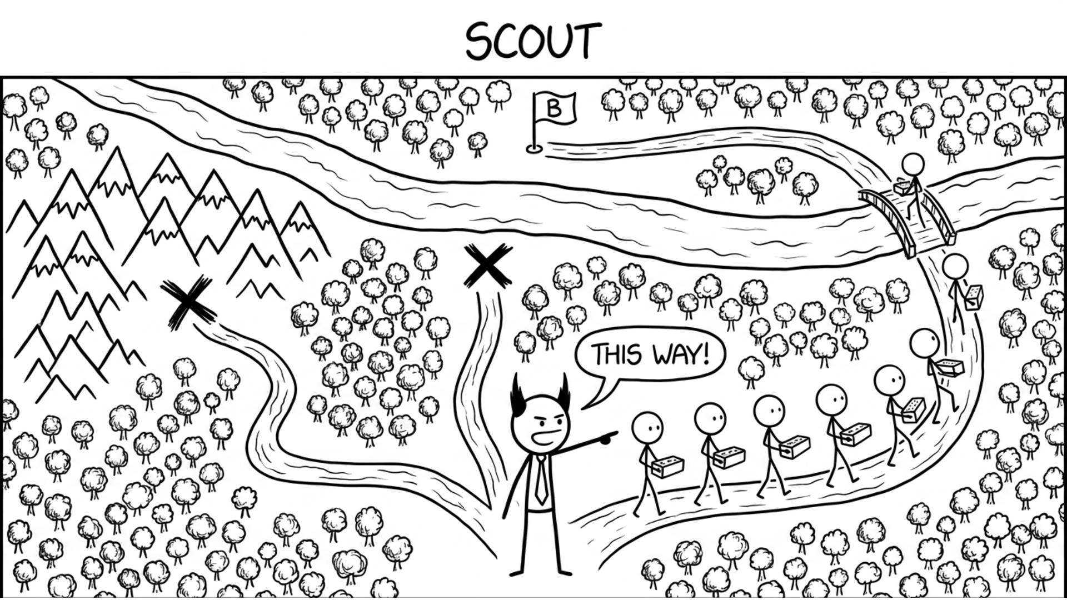
Copyright Dobromir Montauk 2026
Notes:
Scout. On the last slide we picked the mountains with no data. A scout would have found that dead end in two days. Scouting ahead is more work up front, but it's cheaper than committing the whole team to the wrong road for a month.
- Spike the vendor or POS API for two days before promising the integration date: auth quirks, rate limits, missing endpoints.
- Prototype the hard part first (latency, the hardware constraint, the model accuracy), not the easy UI.
- Ask who tried this before. The team that attempted it last year knows where it broke.
- Read the customer's actual setup (network, hardware, existing POS) before estimating.
Send one engineer for a few days, not the whole team for a sprint. The obvious approach is often the one nobody has taken end to end.

Slide 18
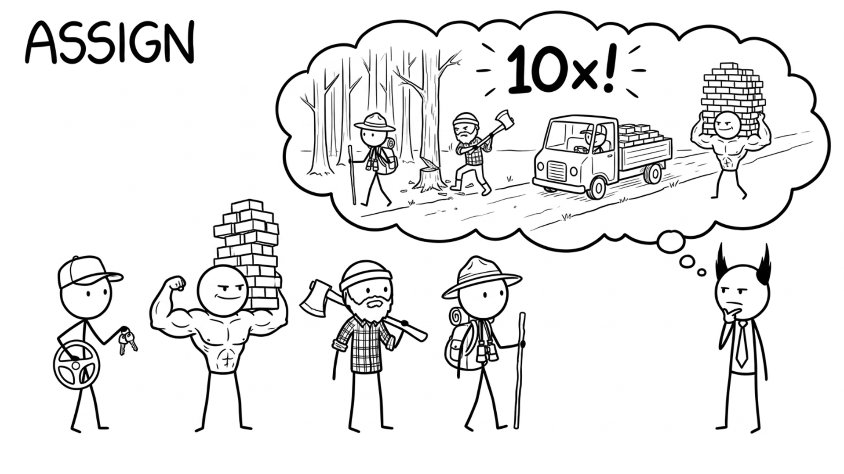
Copyright Dobromir Montauk 2026
Notes:
Assign. Engineers aren't fungible. The person who knows the payment stack fixes the payment bug in a day; someone new to it takes a week.
- Your best debugger goes on the production incident.
- Your best communicator goes on the customer-facing integration.
- Your fastest prototyper takes the spike.
- Watch for assigning by "who's free" instead of "who's best for this".
When one task blocks everything (the release, the P0 bug), swarm it. The tradeoff: always picking the expert creates hero dependency. Spreading knowledge is capacity, and it comes later in the talk.

Slide 19
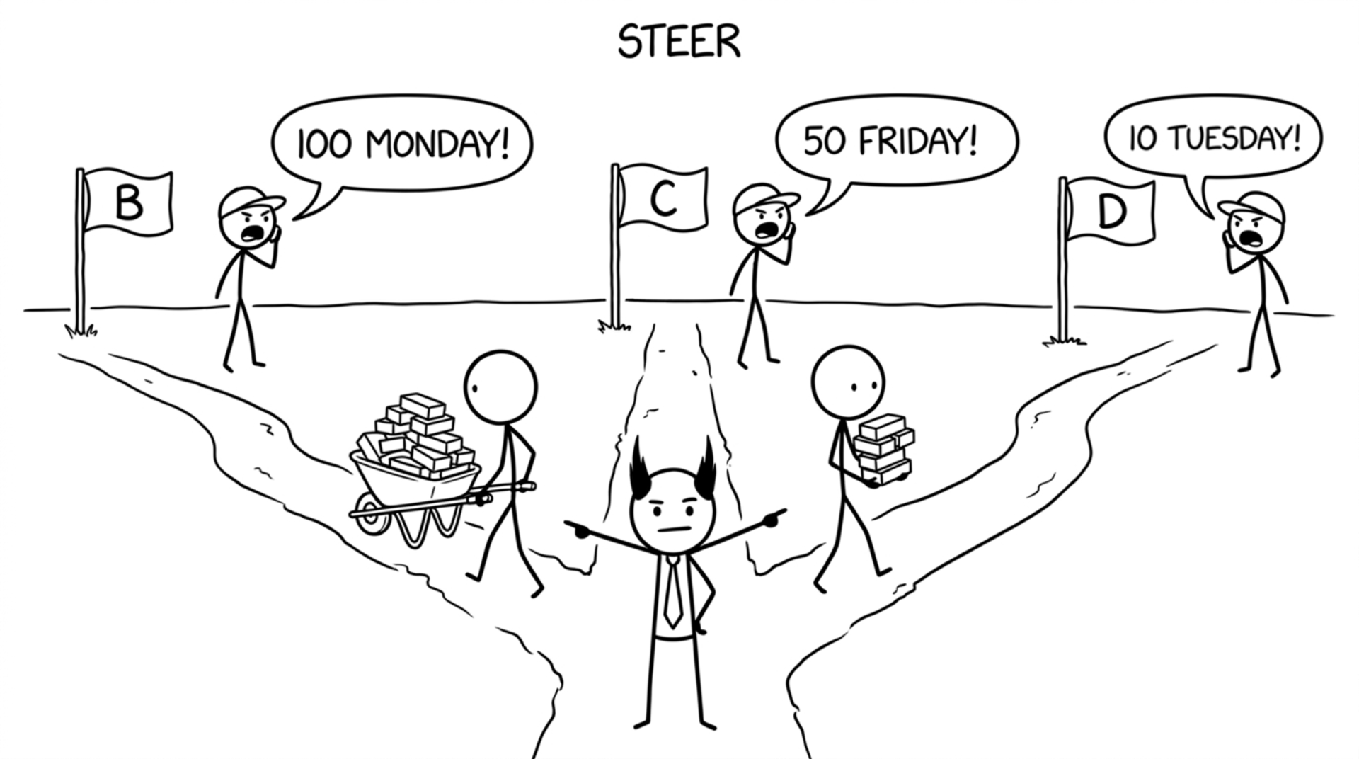
Copyright Dobromir Montauk 2026
Notes:
Steer. Three customers, three deadlines, and each one is sure they're the priority. Your job is to turn the noise into an order: value, deadline, size.
- The big launch due Monday gets most of the team.
- The small fix for a key account due Tuesday gets one engineer, so it ships and is off the board.
- The Friday request waits on purpose, and you tell that customer explicitly, with a date.
Spread the team across all three and everything ships late. Re-check mid-week: did priorities change? Did sales promise something new?

Slide 20
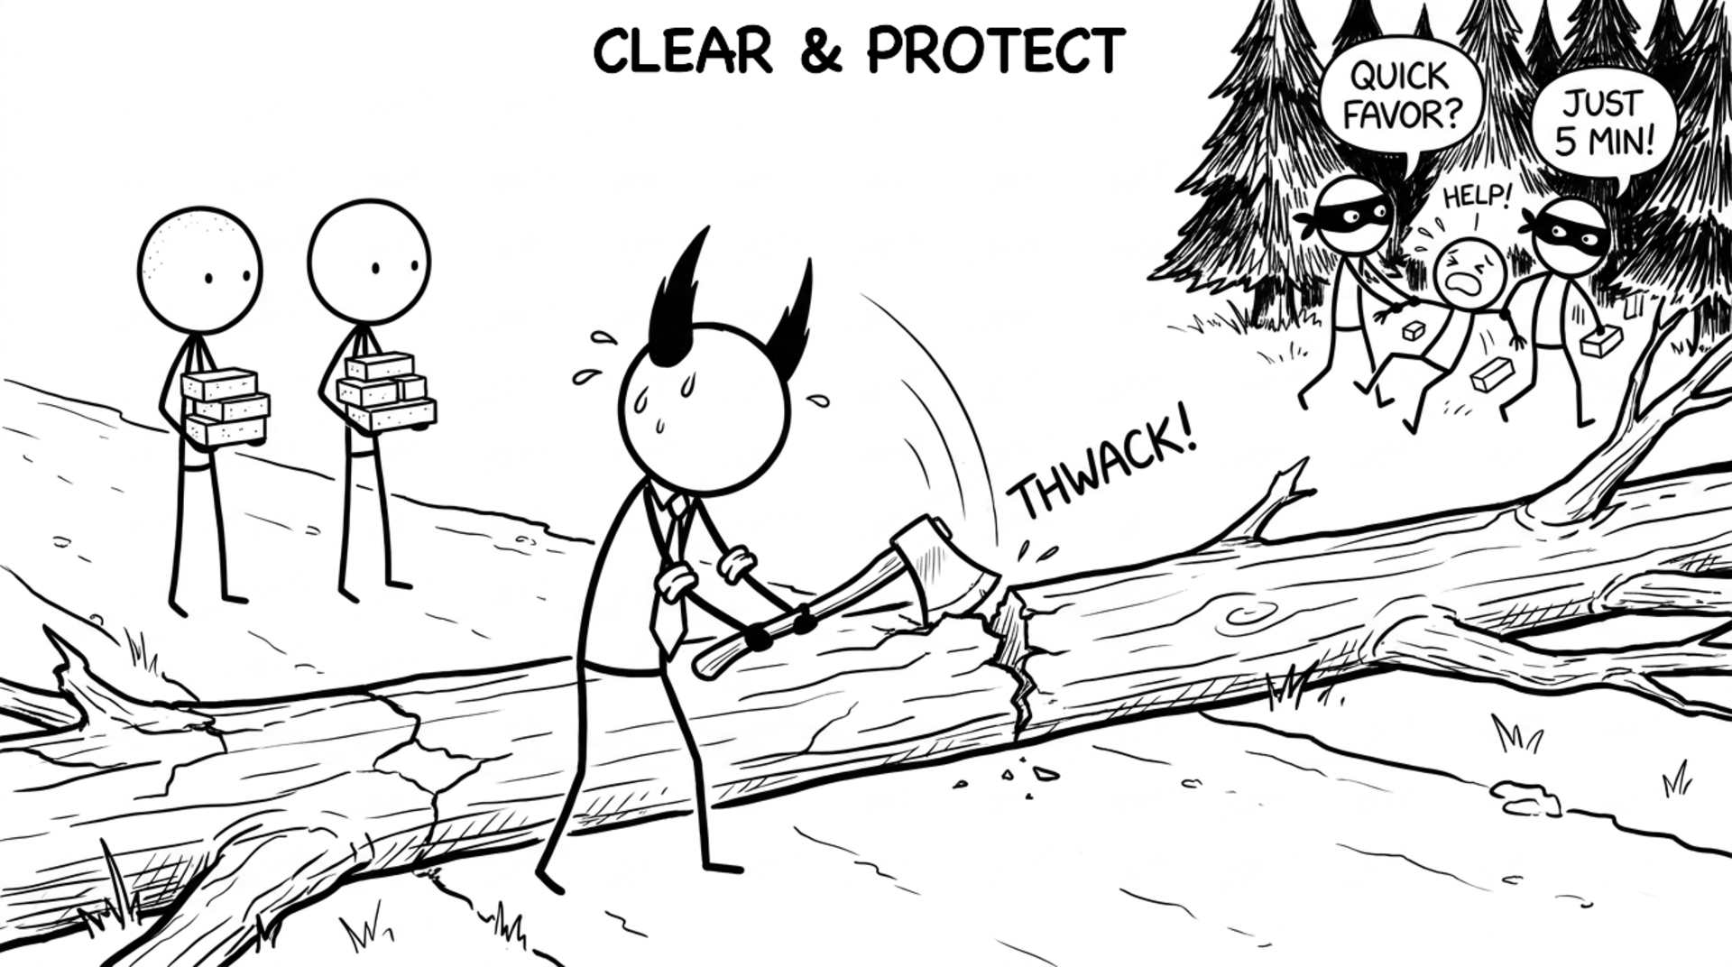
Copyright Dobromir Montauk 2026
Notes:
Clear & Protect. Two kinds of obstacles.
Blockers you can see: waiting on another team's API, missing access or credentials, a flaky CI pipeline, a decision nobody has made. Chasing these down is visible and feels great.
Distractions you don't see: the "quick favor" from sales, the exec who needs "just 5 minutes" every day, an extra interview loop, the side project someone pulled your engineer into. They take your best people one at a time.
Ask in 1:1s where their time actually went last week, and compare it to the plan. Then say no on their behalf.

Slide 21
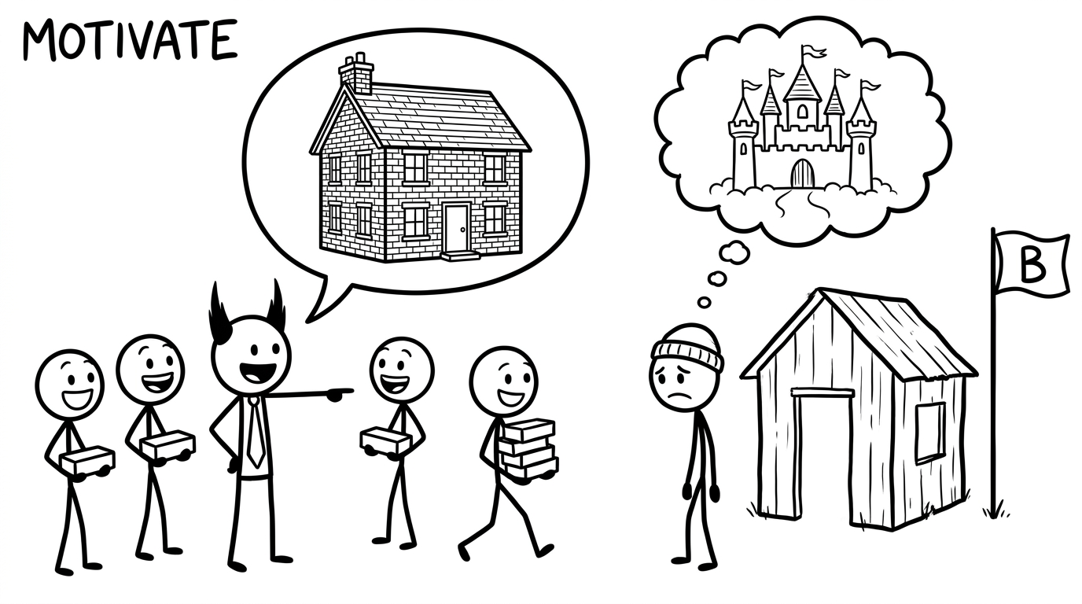
Copyright Dobromir Montauk 2026
Notes:
Motivate. People work harder on things they understand and care about.
- Bring an engineer to a customer site to watch the product being used.
- Share the real number: the revenue, the customer count, the deal this unlocks.
- Connect the project to their career: this is the scope that gets them promoted.
- Celebrate the ship publicly and name who did it.
But don't oversell. If the "company-changing" launch turns out to be a pilot at one site, the next pitch lands flat.
Overtime lives here too. A short push before a hard deadline can win the week, but it borrows from capacity: burnout, attrition and bugs next sprint.

Slide 22
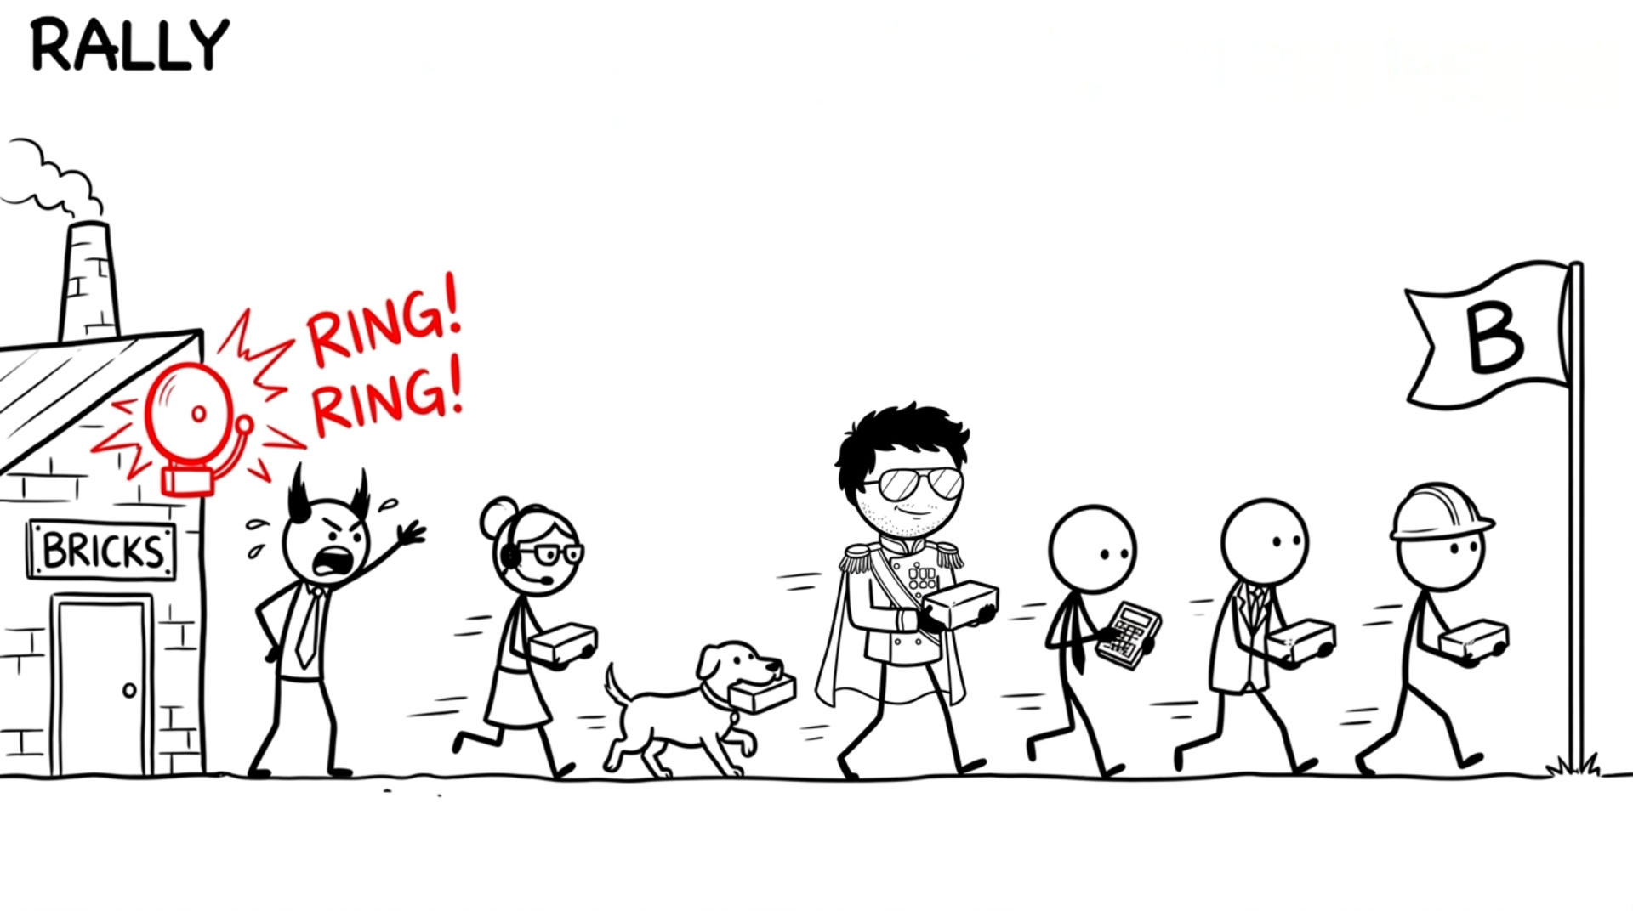
Copyright Dobromir Montauk 2026
Notes:
Rally. Sometimes the deadline is real and immovable, and the only way to make it is to pull in everyone who can help, not just engineering.
- A big customer go-live: PMs run QA test plans, support pre-stages hardware, sales engineers do on-site checks.
- A P0 outage: the exec clears their calendar to handle customer comms so engineers can stay heads-down.
- A launch week: designers write release notes, ops does install checklists, the CTO reviews PRs.
Make it explicit: declare it, give it an end date, and give each person a concrete, small task they can actually do. Then stop. If you're rallying everyone every month, it isn't a rally; it's a planning problem, and that's capacity.

Slide 23
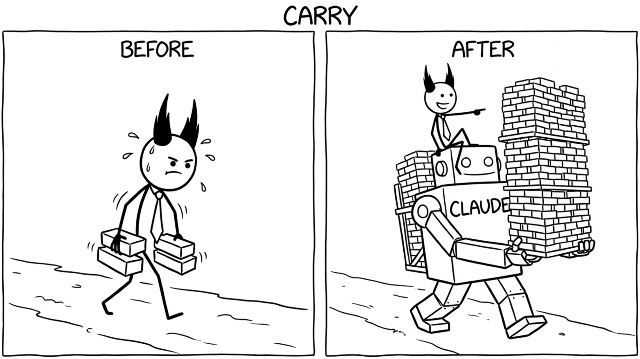
Copyright Dobromir Montauk 2026
Notes:
Carry. The old rule: managers shouldn't code. Your hours are fragmented, and if you take a critical-path ticket, it stalls every time you get pulled into a meeting.
What changed: with an AI coding agent, a 30-minute gap between meetings is enough to ship something real.
- Write the one-off migration or data-fix script nobody has time for.
- Prototype the feature to answer "is this even feasible?" before the planning meeting.
- Build the internal dashboard or report that ops has asked for twice.
The rule that hasn't changed: stay off the critical path. Carry the work that would otherwise never get done, not the work that blocks the team if you disappear for a day.

Slide 24
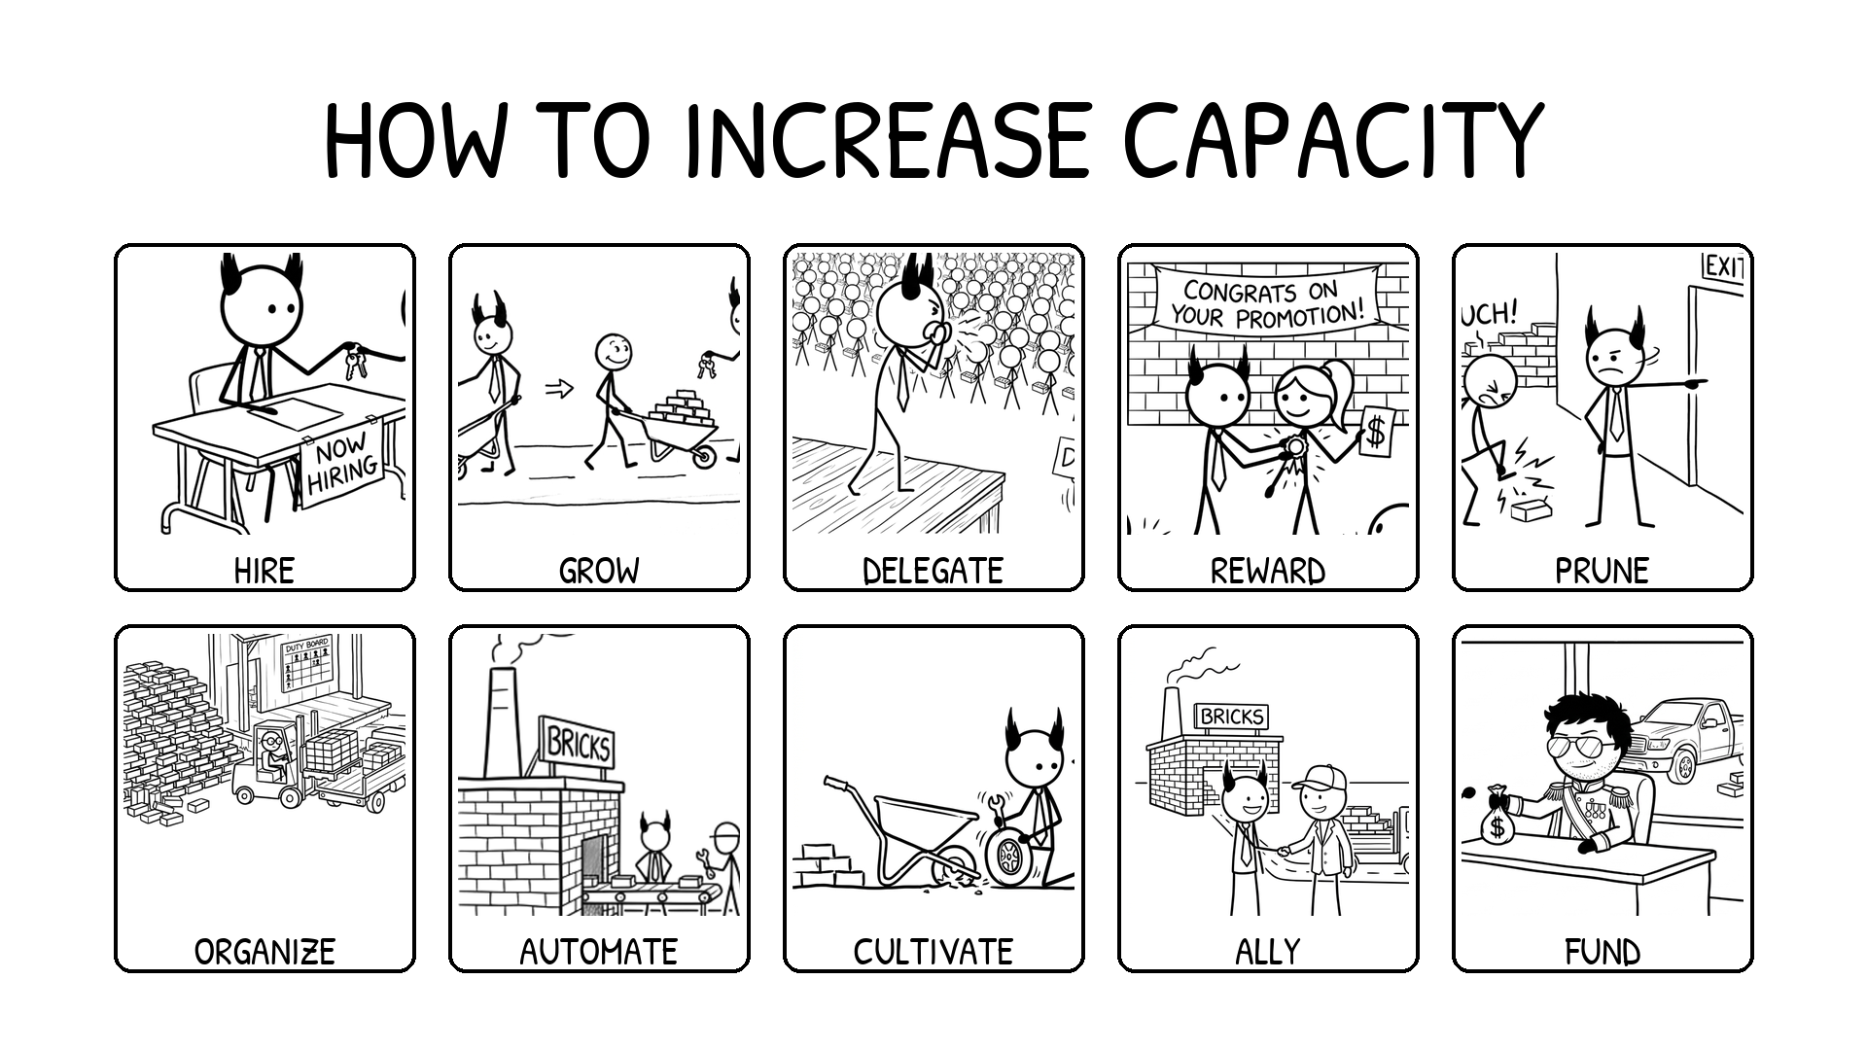
Copyright Dobromir Montauk 2026
Notes:
How to increase capacity. Everything on this slide pays off in months or years, not this week, which is why it always loses to this week's fire. Nobody will ask you on Friday why you didn't do a skip-level or fix the on-call rotation. Six months later, everyone will ask why the team is still slow. Block time for these the way you block time for a launch.

Slide 25
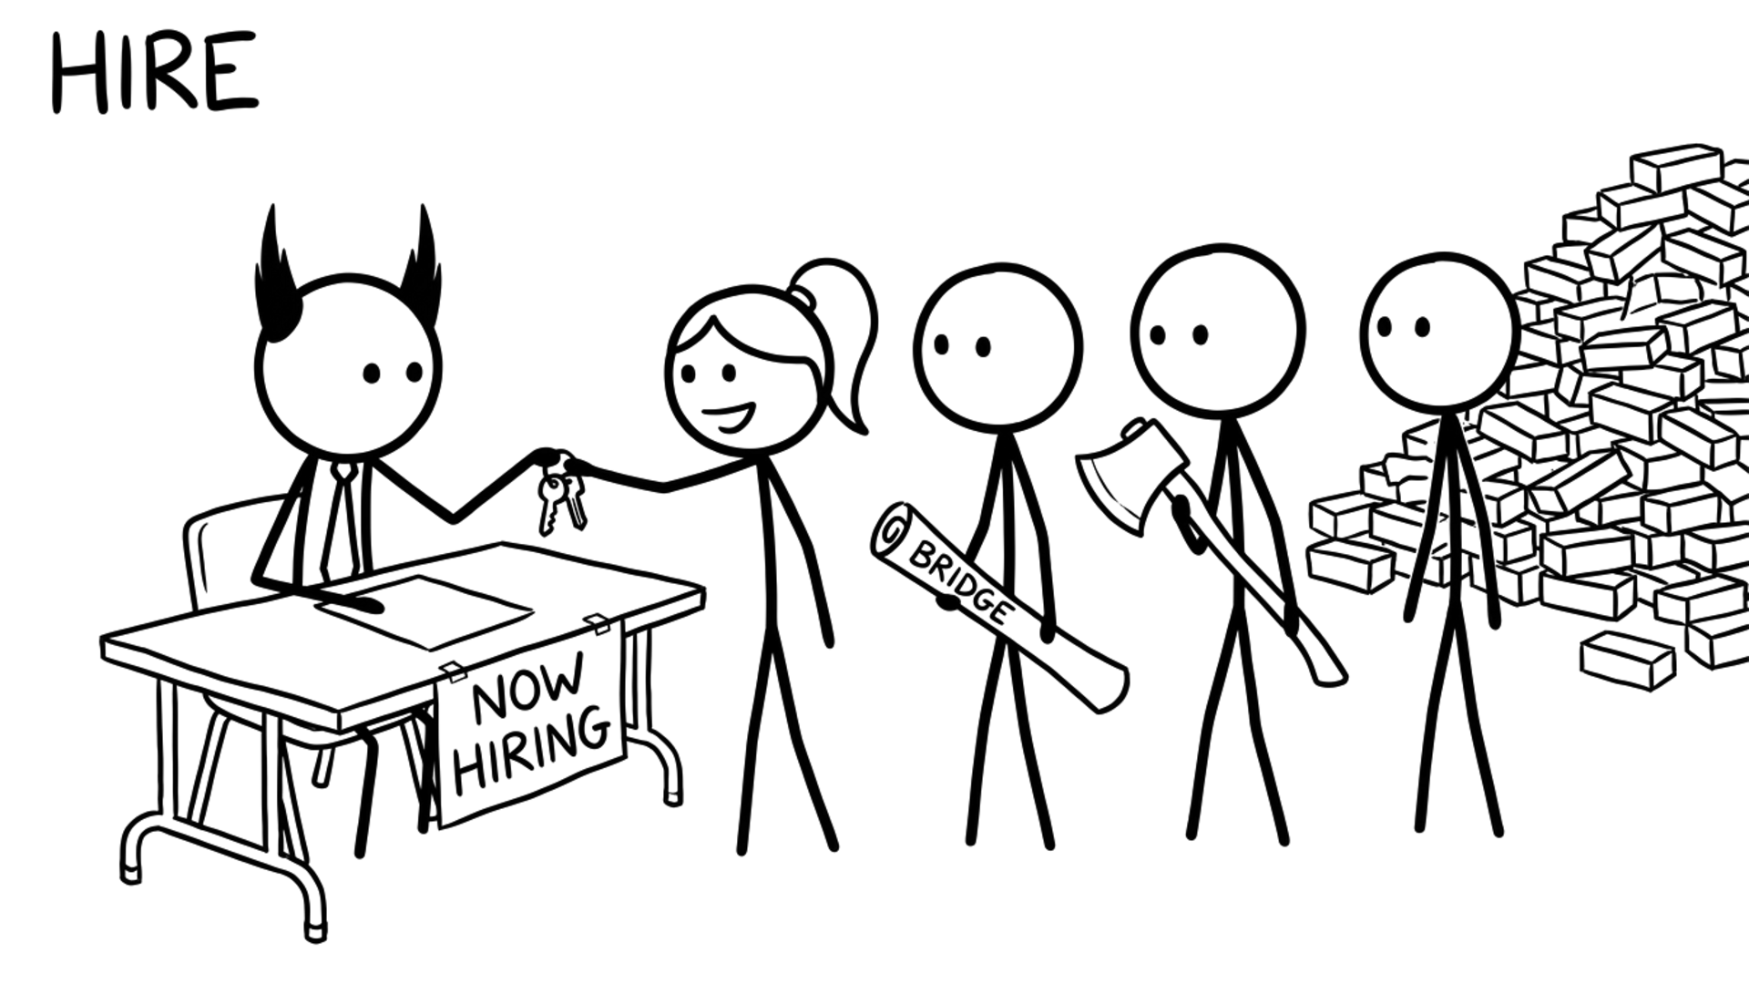
Copyright Dobromir Montauk 2026
Notes:
Hire. Hiring is the second thing your CEO judges you on, after delivery, because it's where everything else becomes visible: candidates can smell your culture, your strategy and whether you grow people.
- Hire for the gap, not the clone: the team that's all backend needs the person who has shipped mobile.
- One great senior hire can be worth three average ones; a bad hire is net negative and costs months to undo.
- Make your recruiter a real partner: if they can't explain why the role is exciting, candidates won't feel it.
- Every interview loop costs the team 5–10 engineer-hours. Budget for it.
Hiring is slow capacity: it takes 3–6 months before a hire is fully ramped. Start before you're desperate.

Slide 26
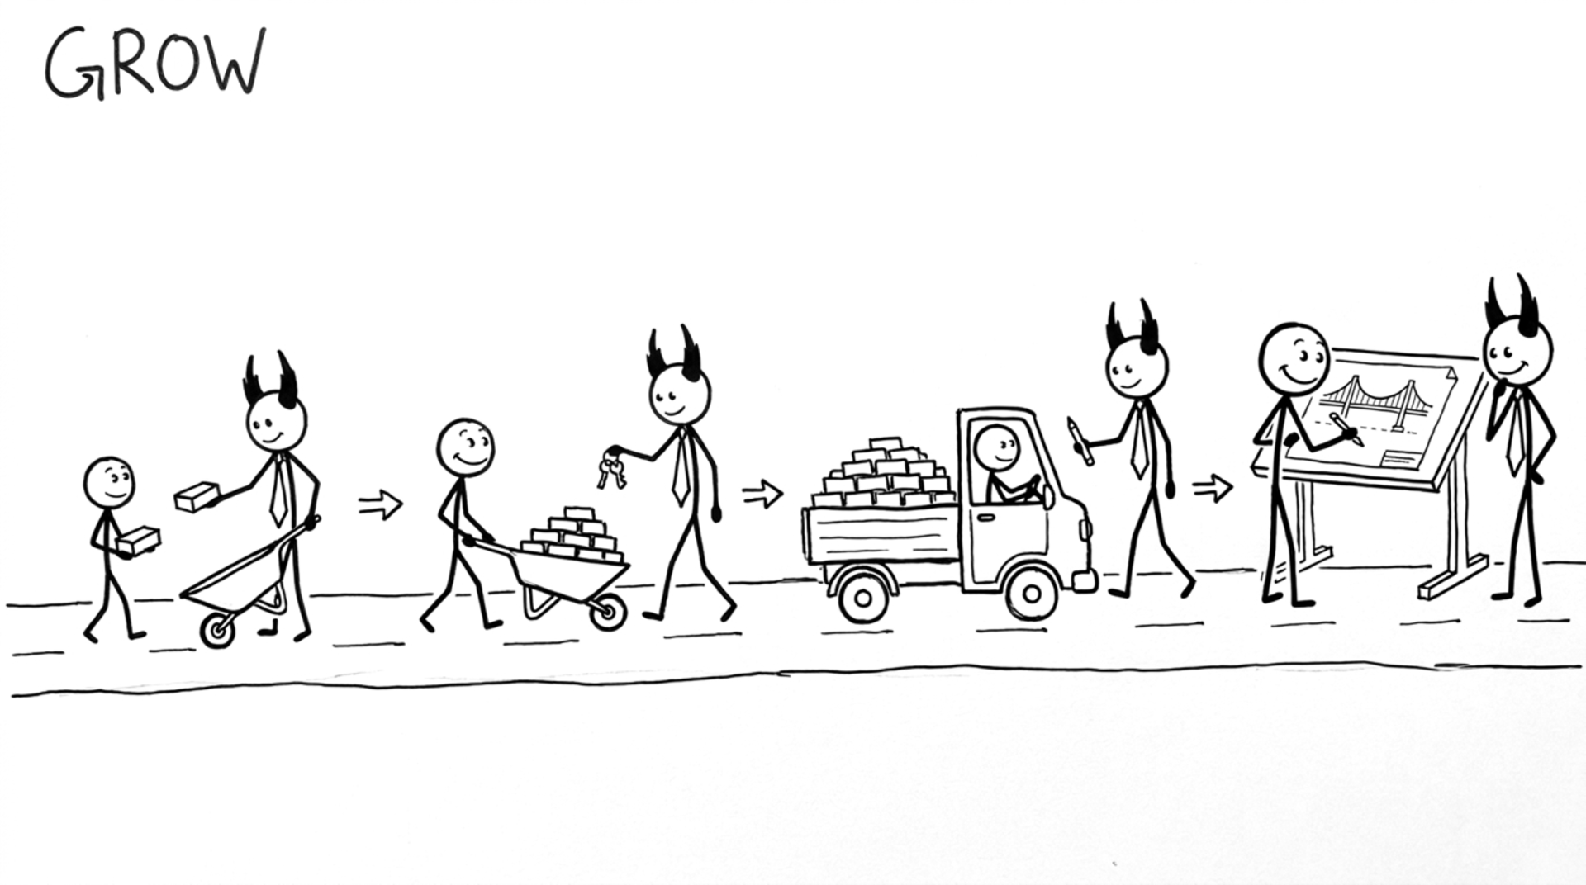
Copyright Dobromir Montauk 2026
Notes:
Grow. This could be a whole set of talks. Three parts:
1. Opportunities: give people work one size bigger than their last job. The mid-level engineer leads the next design review; the senior engineer owns the launch.
2. Mentorship: show how to do the job. Do it together first: you run the incident review while they watch, then they run it while you watch.
3. Coaching: support them while they do the job on their own. Weekly 1:1s, feedback within days, and questions instead of answers.

Slide 27
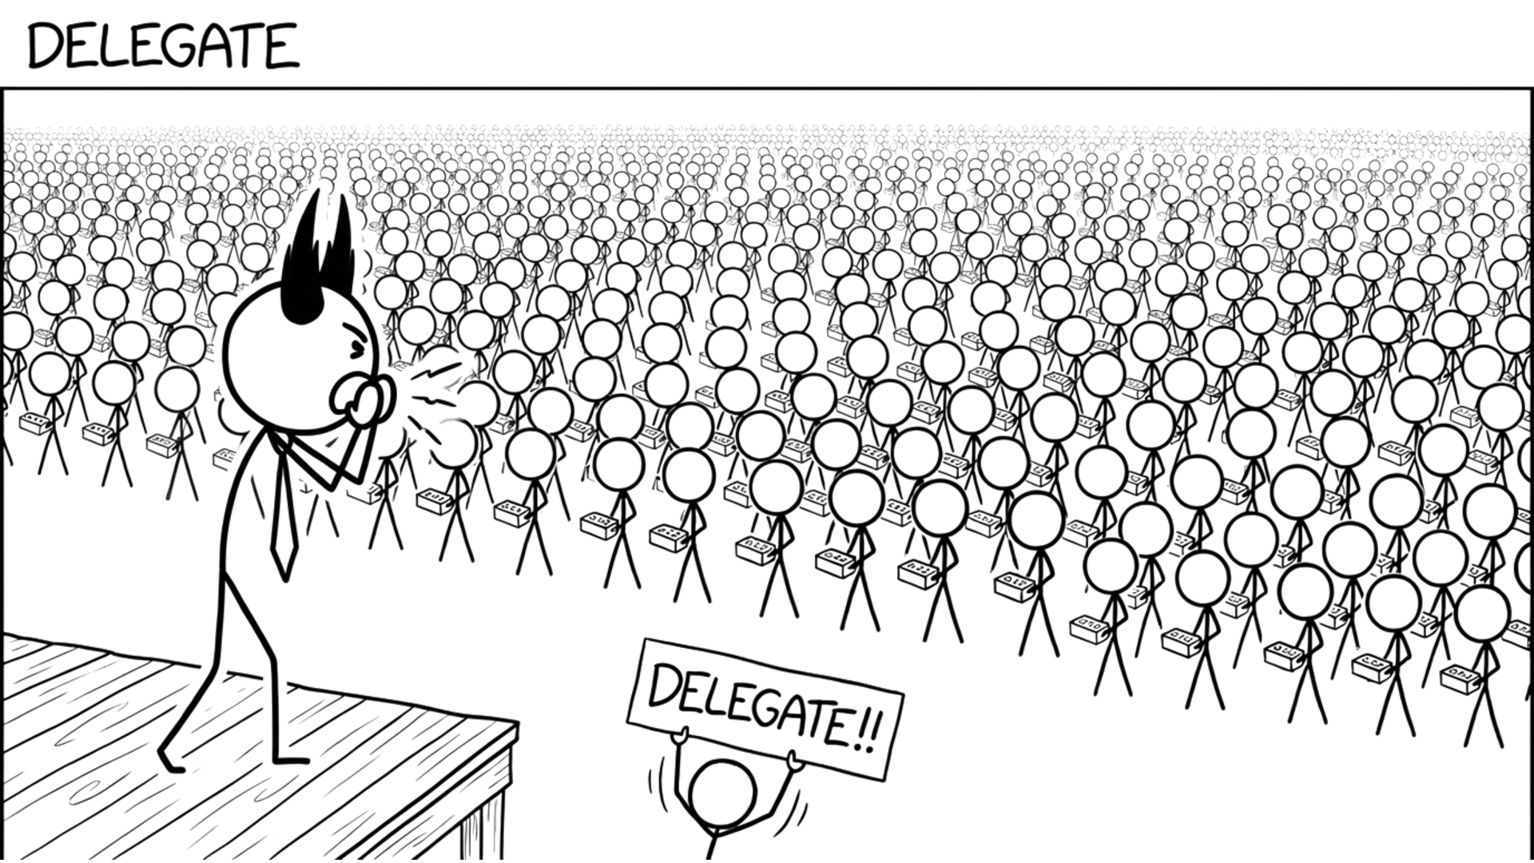
Copyright Dobromir Montauk 2026
Notes:
Delegate. At some point your own hours are the bottleneck. Delegating is how one manager's capacity becomes several.
- Tech leads who own the technical calls, so design decisions don't queue behind you.
- A second-in-command who can run the team for two weeks while you're out, and actually does it.
- Hand off whole problems (the release process, the on-call rotation), not tasks.
- Let them do it differently than you would. If it's 80% as good and you didn't have to do it, that's a win.
The test: if you disappear for a week, does the team slow down?

Slide 28
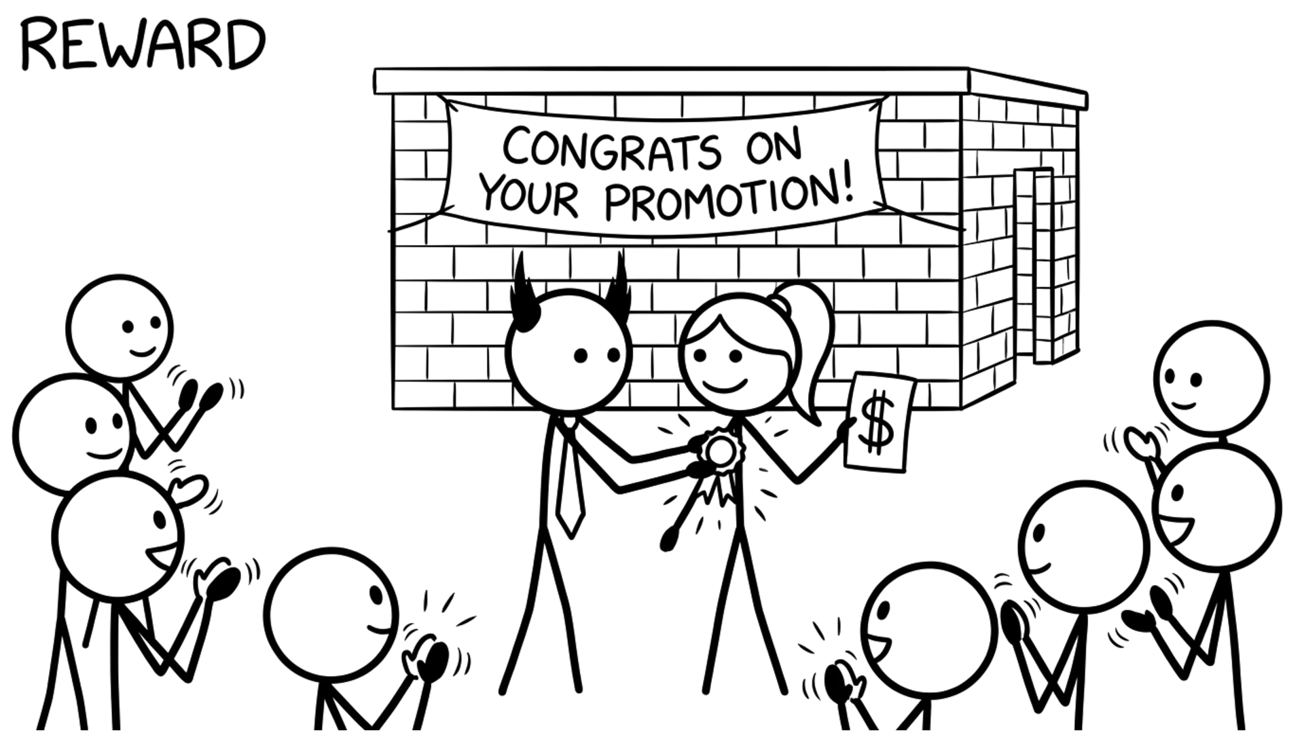
Copyright Dobromir Montauk 2026
Notes:
Reward. "My job is to leave money in your pocket and memories in your head."
- Pay fairly and proactively: fix the underpaid engineer before they get the outside offer, not after.
- Equity and refreshers tied to impact, explained clearly.
- Recognition that's specific and public: name the person and what they did, in the all-hands, not just in a DM.
- Non-money rewards: the interesting project, the conference talk, the promotion case you write for them.
Money prevents a no. It rarely creates a yes.

Slide 29
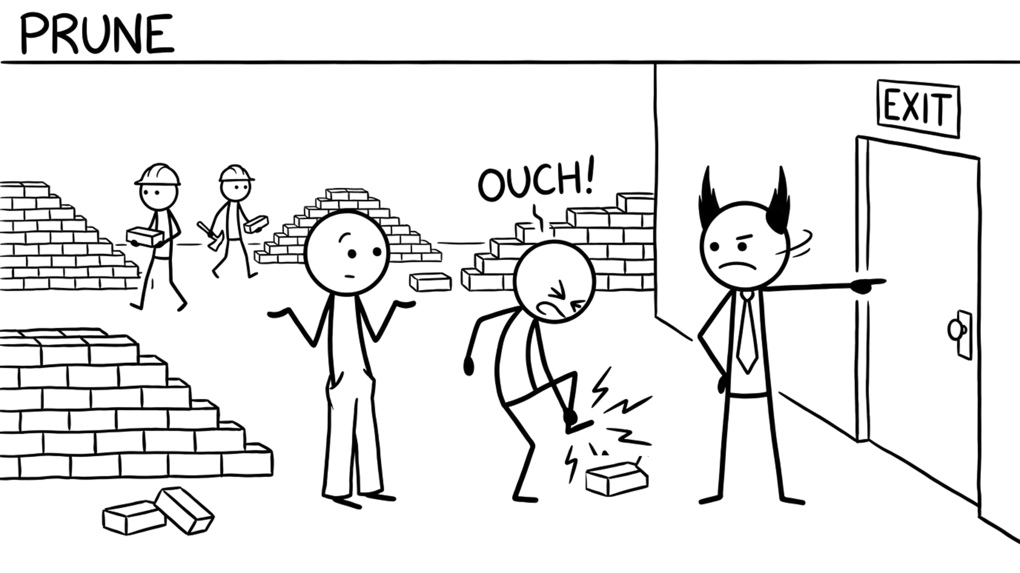
Copyright Dobromir Montauk 2026
Notes:
Prune. Sometimes capacity goes up when someone leaves.
- One person who blocks every review, or who the team quietly routes around, slows down everyone near them.
- Values rarely change; skills can. Coach skill gaps. When it's values, move faster than feels comfortable.
- Be clear early: written expectations, a real plan, a date. Nobody should be surprised.
- "Not firing fast enough" is one of the most common regrets of experienced managers.
Do it with dignity. The rest of the team is watching how you treat people on the way out.

Slide 30
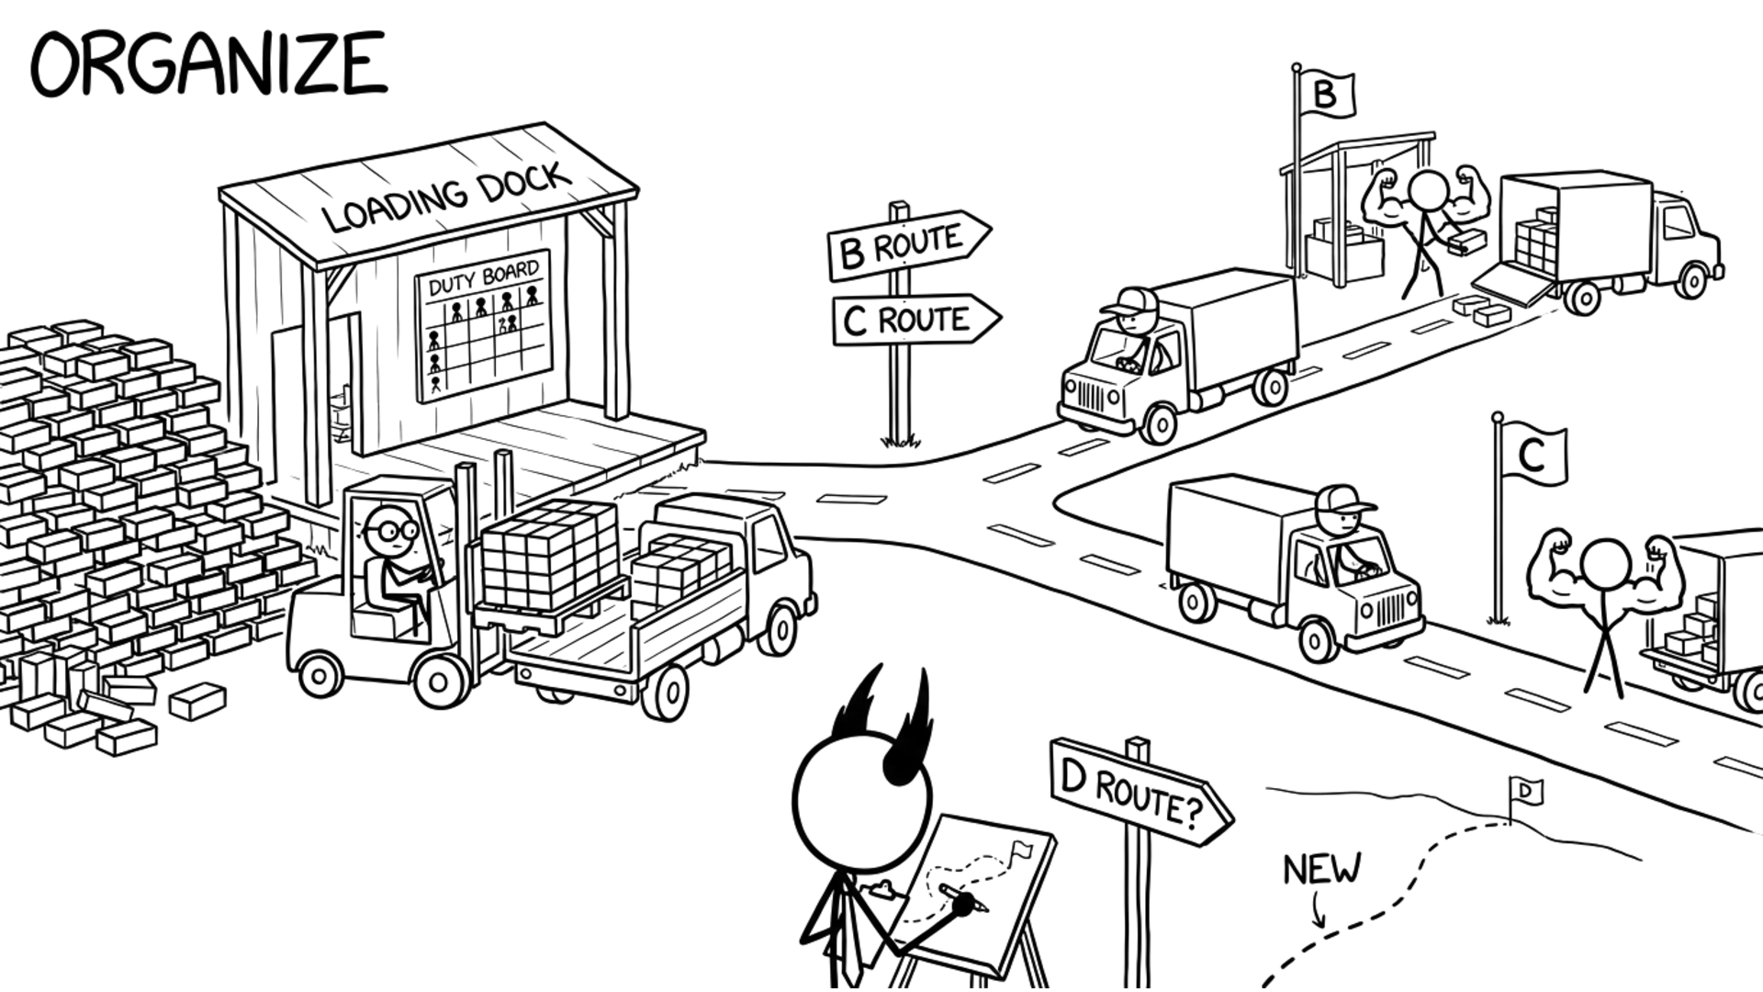
Copyright Dobromir Montauk 2026
Notes:
Organize. Assign is who carries which brick this week. Organize is the structure that makes that call for you every week, so you can work on the next route. The shape of the team decides how much it can do.
- Clear ownership: every service, every alert and every customer issue has one team that owns it.
- Small teams with few dependencies ship faster than one big team with many.
- Few, explicit handoffs: product to engineering, engineering to QA, QA to support.
- An on-call rotation that doesn't burn out the same two people.
- Just enough process: a weekly plan, a retro, a postmortem. Kill the meetings nobody would miss.

Slide 31
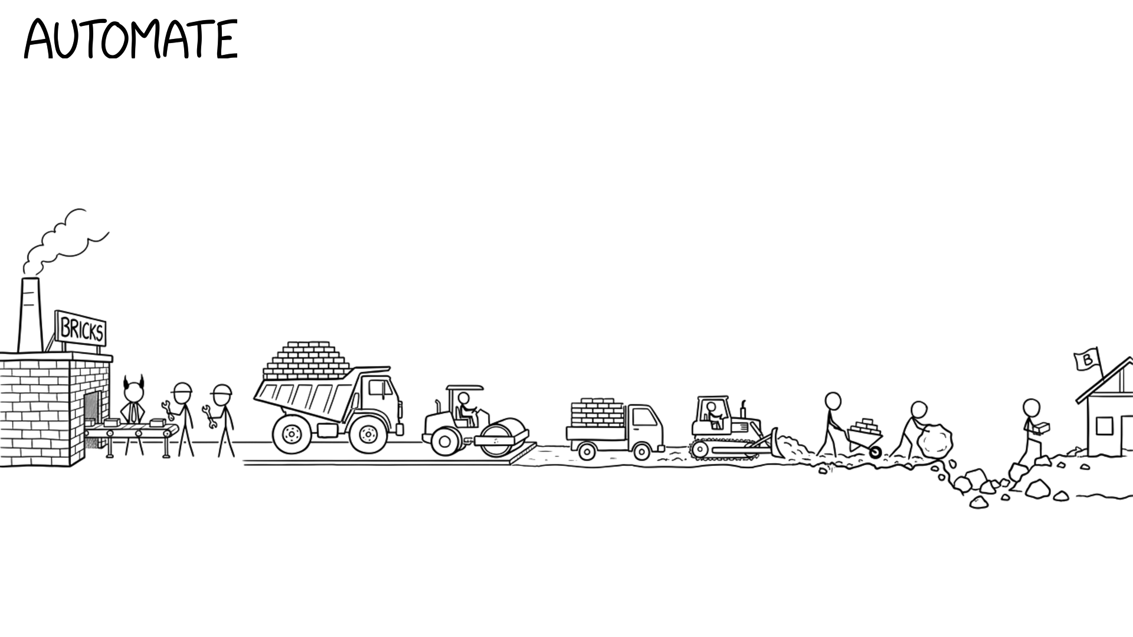
Copyright Dobromir Montauk 2026
Notes:
Automate. Every hour of toil you remove pays back every week after. Each level of technology is roughly 10x the last, and you build the next level while the current one keeps delivering.
- The page that costs an hour a week and takes 12 hours to fix pays back in 12 weeks. Fix it.
- CI that takes 40 minutes taxes every PR, every day.
- Deploys that need a person and a checklist become deploys that need a button.
- Pay down the tech debt that slows every feature, not the debt that just looks ugly.
- AI agents on the repetitive work: test writing, migrations, triage.
Build it while you keep shipping. Stop delivering to build the perfect tool, and you lose the week and the trust.

Slide 32
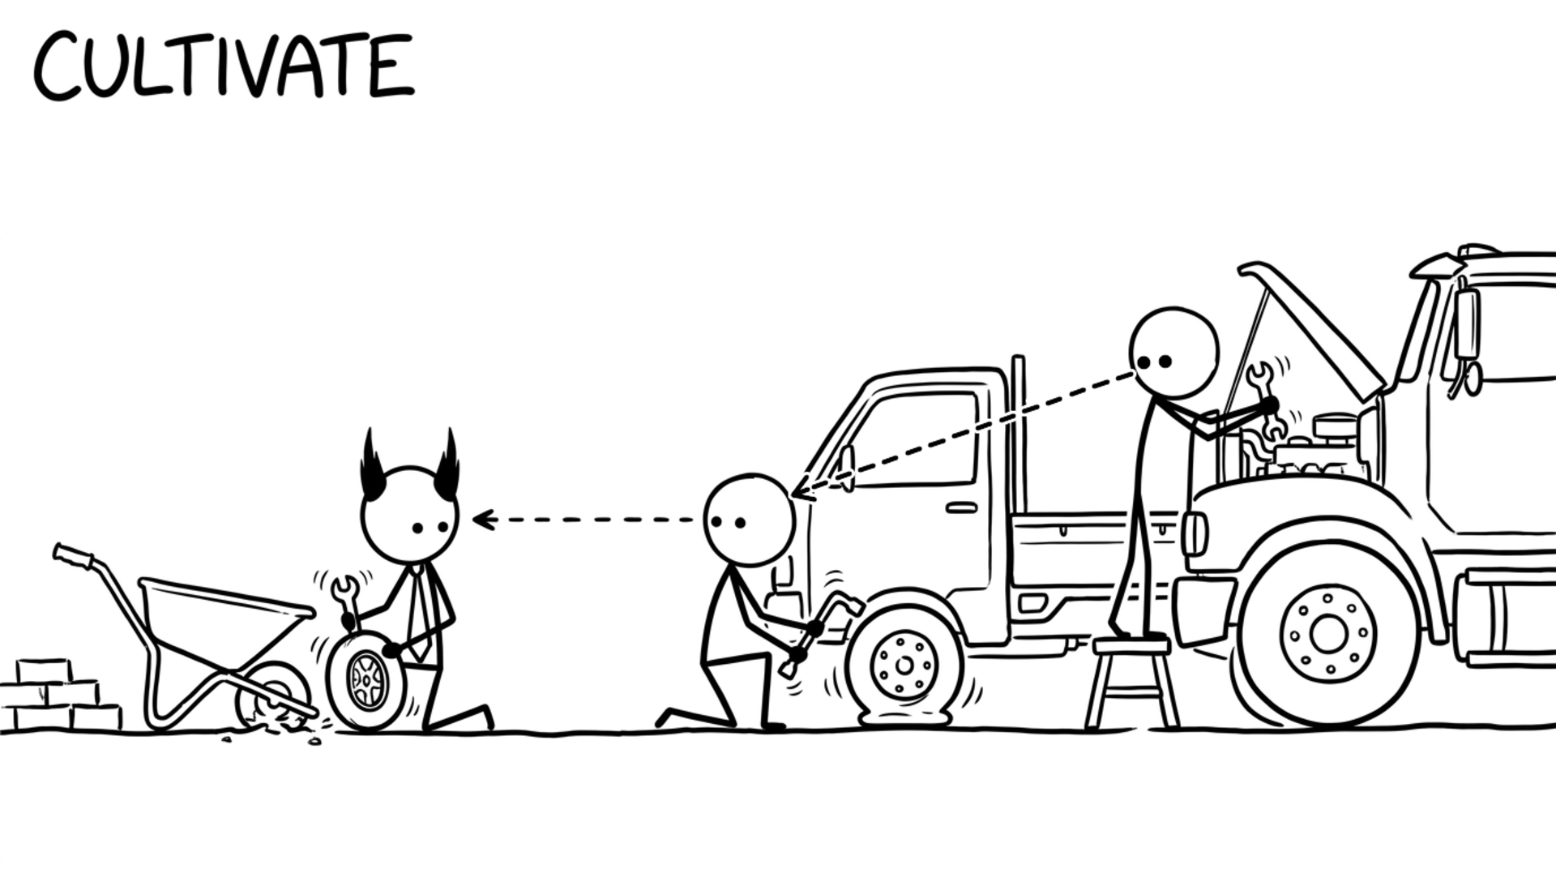
Copyright Dobromir Montauk 2026
Notes:
Cultivate. Culture is what people copy. Your team copies what you do, not what you say, and the next hire copies them, long after they've stopped watching you.
- You break prod: you write the postmortem, and it starts with your own mistake. Six months later, a junior engineer opens theirs the same way.
- You fix the flaky test instead of hitting re-run. Your tech lead stops re-running, and so does the new hire.
- You review PRs within a day, with a real comment, not just LGTM. That becomes the team's review bar.
- You say "I don't know, let me find out" in a design review. People stop bluffing.
Then make it explicit: a few words people can act on, like "Rigorously Get Shit Done". Reward what you say you value; if you say quality but celebrate only speed, the team copies speed. Hire and fire by it.
It's slow to build and fast to lose.

Slide 33
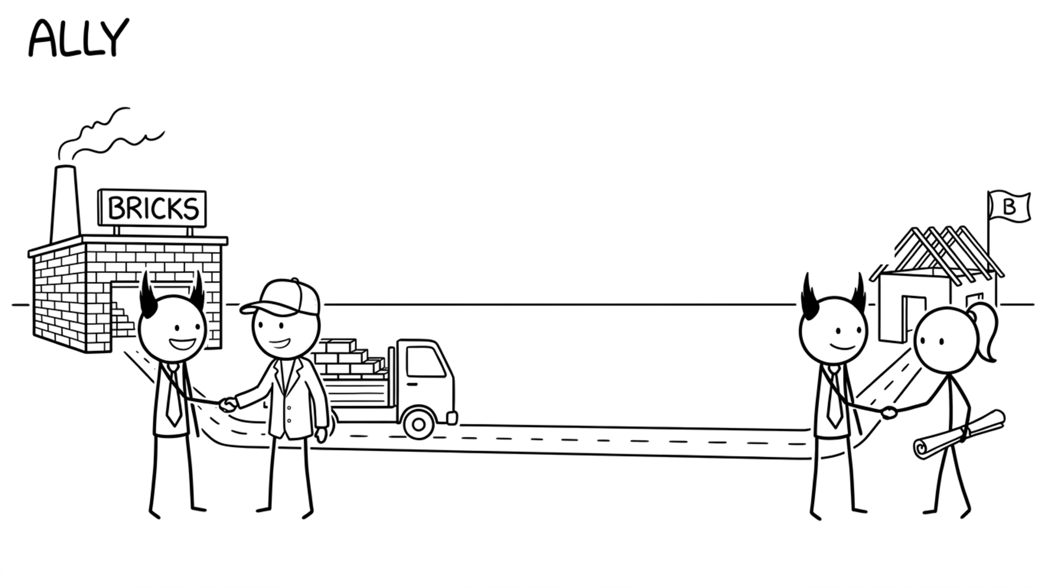
Copyright Dobromir Montauk 2026
Notes:
Ally. Other functions' capacity can become yours. Engineering can't win alone, and the partners who trust you will spend their capacity on your goals.
- Product: a partner, not a requester. You plan the roadmap together, they cut scope with you instead of around you, and they bring you to the customer.
- Sales: they tell you which deals need what, months before the contract is signed, and they don't sell the feature you haven't built. In return, you give them dates you actually hit.
- Also: the platform team that adds the API you need if they hear about it a quarter ahead, and the recruiter who moves faster on your hires.
Alliances are built before you need them, not during the crisis.

Slide 34
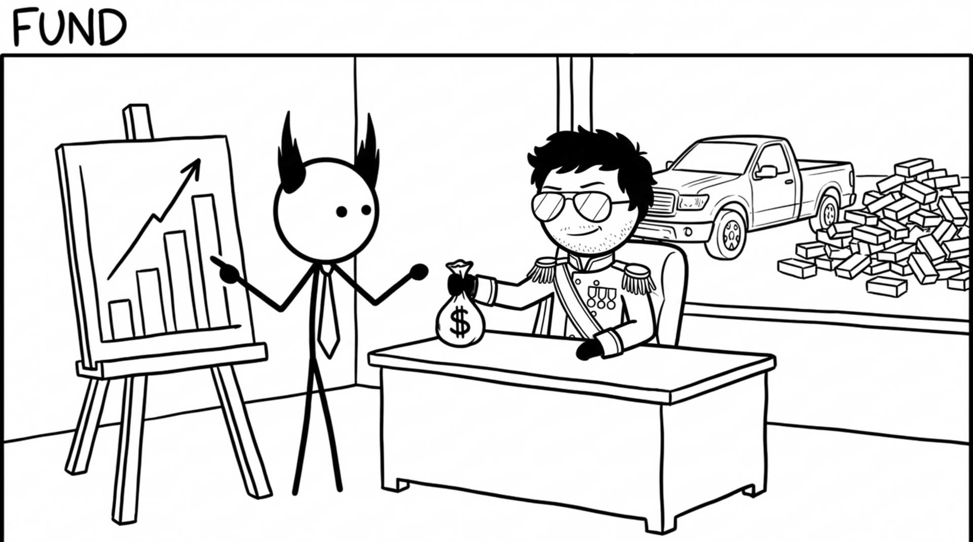
Copyright Dobromir Montauk 2026
Notes:
Fund. Headcount and budget are capacity, and you have to earn them.
- A hiring plan and a comp plan that tie each dollar to an outcome the CEO cares about.
- Stay on budget, and share bad news early. Nothing builds CEO trust faster.
- Ask for the truck with a business case: what it costs, what it unlocks, when it pays back.
- Start small and earn more: a two-day draft, reviewed together, then sharpen the numbers.
Every yes from the CEO is spent from trust you built earlier.

Slide 35
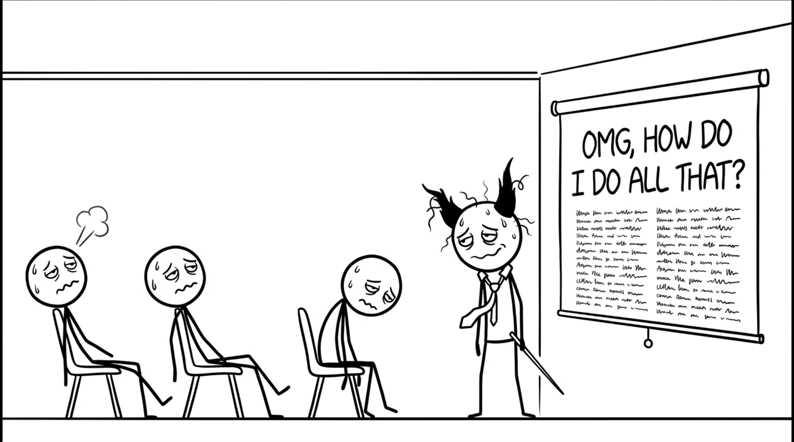
Copyright Dobromir Montauk 2026
Notes:
OMG, how do I do all that? Twenty buckets. Nobody does all twenty every week, and nobody should try. I don't. In any given week, two or three of them matter, and the rest can wait. The hard part isn't knowing the buckets; it's knowing which two or three this week, because the world keeps changing under you.

Slide 36
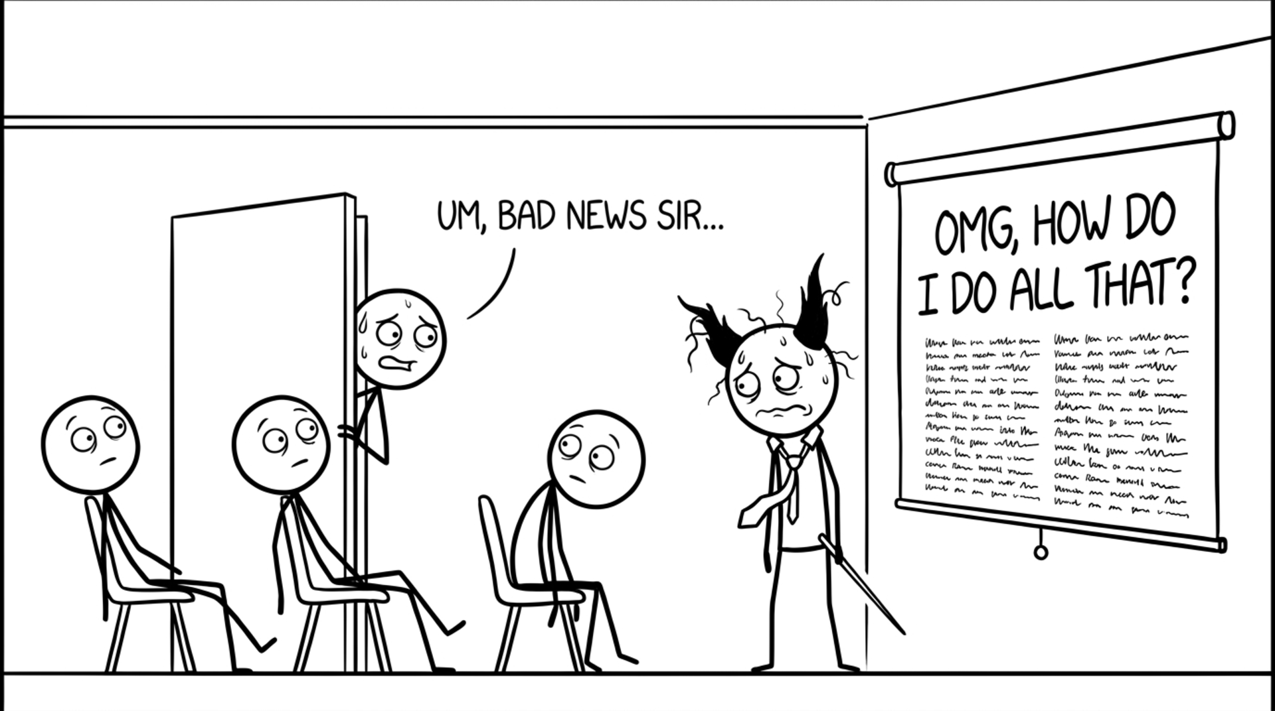
Copyright Dobromir Montauk 2026
Notes:
Bad news. Let it sit for a second. You will get this message on the day you finally have a plan you like. Every manager has had the Slack DM that starts with "hey, got a minute?" at 4:55 on a Friday. It's not a sign the plan was bad. It's what the job actually looks like.

Slide 37
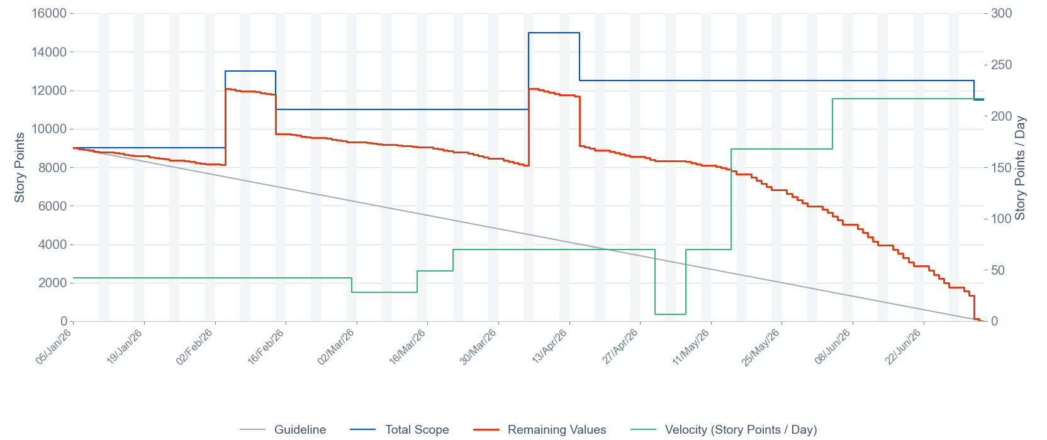
Project Status: H1 Delivery Burndown
Board: ENG-CORE · Sprints 1–13 · Estimation: Story Points
CONFIDENTIAL · Internal Use Only · Slide 37
Copyright Dobromir Montauk 2026
Notes:
Project status. Read it in your most monotone voice. Reality is incredibly messy: unpredictable things happen all the time. This is how half a year of it looks in the status meeting: two bumps and a line that hits zero. All the chaos is in there; you just can't see it anymore.

Slide 38
Key Responsibilities: Summary
1. Winning
2. Increasing the Capacity to Win
Ensure alignment of deliverables with key stakeholder objectives
Right-size scope to optimize time-to-value
Conduct proactive risk assessment and discovery
Drive timely decision-making across workstreams
Optimize resource allocation against priority initiatives
Monitor execution and course-correct as needed
Remove impediments and mitigate external dependencies
Foster team engagement and ownership of outcomes
Mobilize cross-functional resources for critical milestones
Contribute directly to delivery as bandwidth permits
Execute on headcount plan to address capability gaps
Invest in talent development and career pathing
Empower leads through structured delegation frameworks
Implement competitive total rewards and recognition programs
Proactively manage underperformance
Optimize organizational design and operating model
Leverage automation to drive operational efficiencies
Champion a culture aligned with company values
Build strategic cross-functional partnerships
Secure budget and resourcing in line with business case
CONFIDENTIAL · Internal Use Only · Slide 38
Copyright Dobromir Montauk 2026
Notes:
Key responsibilities. Don't read it. Let the room scan it for a few seconds. Every one of these is a slide we just did, with all the life squeezed out. This is what the job description says.

Slide 39
Key Takeaway
Your job is to deliver, regardless of the chaos.
CONFIDENTIAL · Internal Use Only · Slide 39
Copyright Dobromir Montauk 2026
Notes:
Key takeaway. Flat, like the cover. Pause. It's true, and it sounds like nothing. Then click.

Slide 40
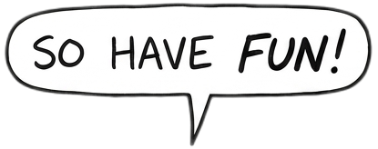
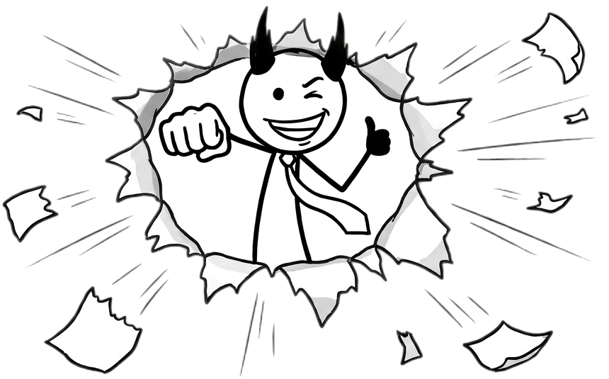
Key Takeaway
Your job is to deliver, regardless of the chaos.
CONFIDENTIAL · Internal Use Only · Slide 39
Copyright Dobromir Montauk 2026
Notes:
So have fun! Drop the corporate voice. It's the hardest job I know and the most fun I've had. Thank you.

